Slide 1
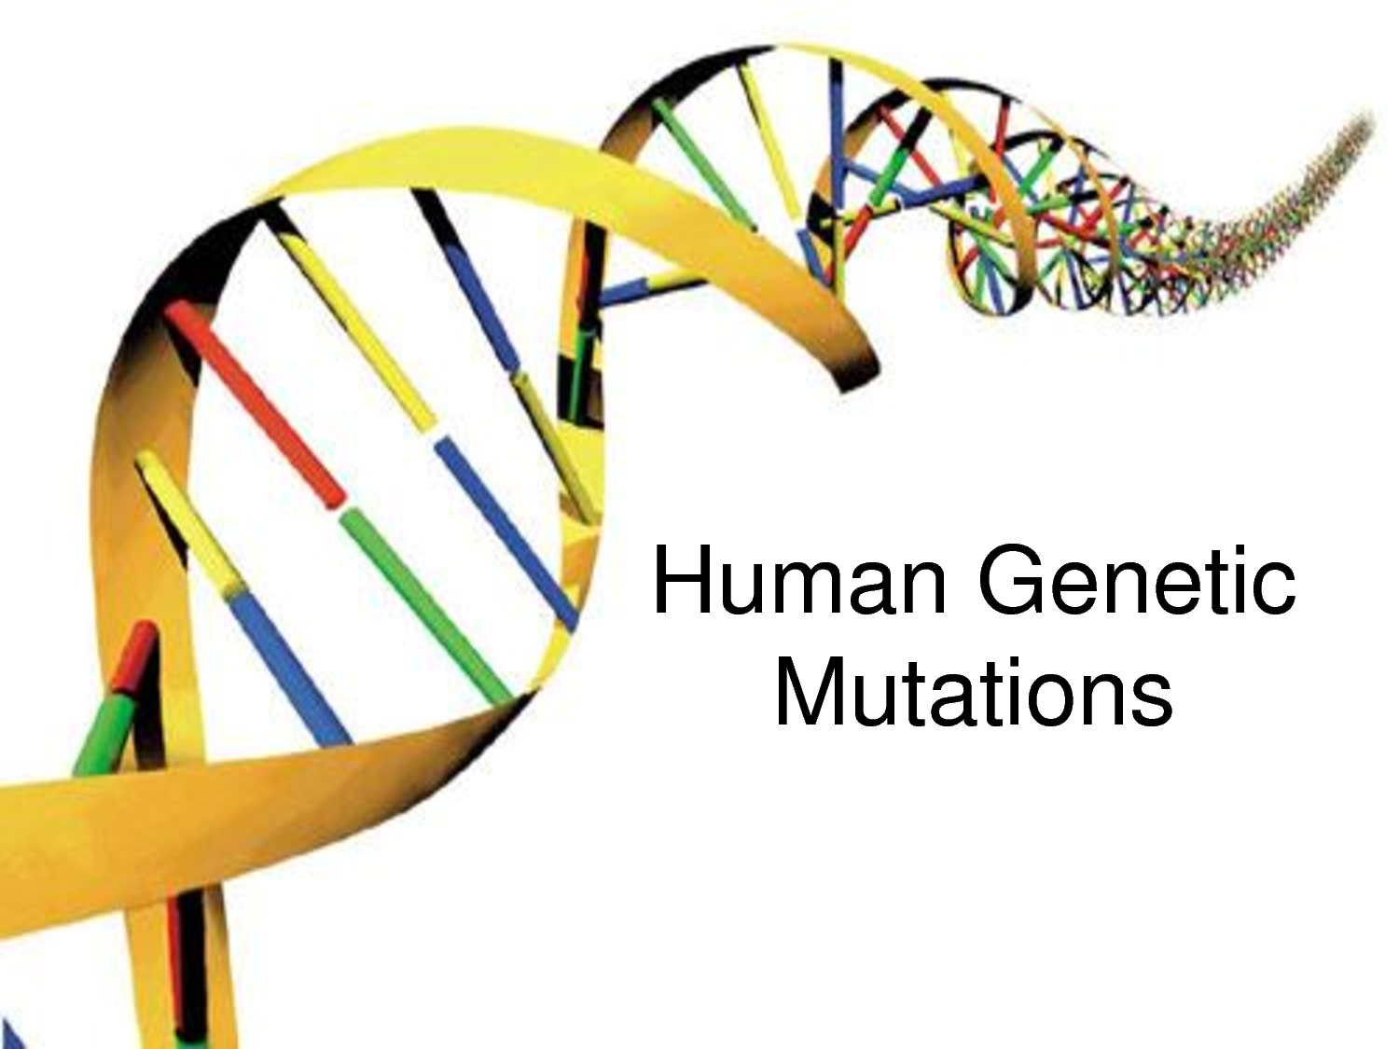
GENES, MUTATIONS & DISEASES:
UNDERSTANDING THE ORIGINS OF GENETIC DISORDERS
http://www.raogk.org/dna/

Slide 2
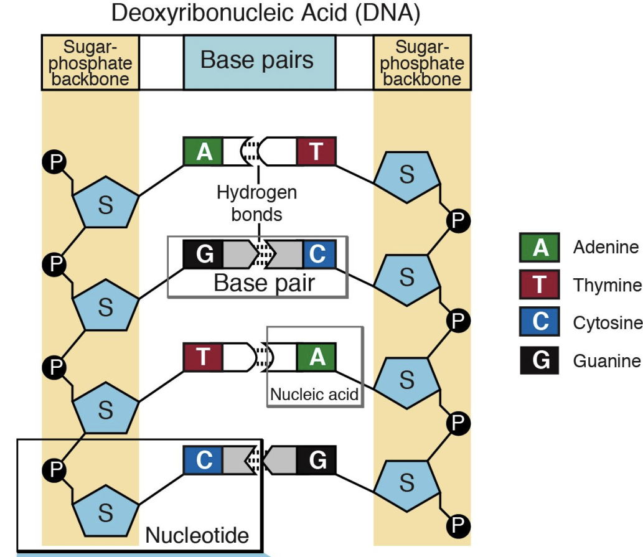
PREVIOUSLY…
Nucleotides, DNA, and Genes
http://igbiologyy.blogspot.com/
http://knowgenetics.org/
Notes:
Briefly, review the main concepts from the last lesson. Start with reminding them the goal of the program: to understand genetic diseases using the example of sickle cell. Then, remind them what genes and DNA are. They need to be reminded of nucleotides and hydrogen bonding because they will see them again in RNA.

Slide 3
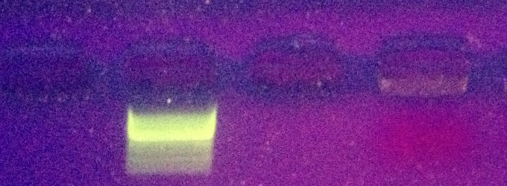
PREVIOUSLY…
Nucleotides, DNA, and Genes
Water DNA Ladder Protein Strawberry DNA
Notes:
Only DNA will be visible in the agarose gel. Hence, why we only see the bands for the DNA ladder and extracted Strawberry DNA.

Slide 4
LESSON #2

Slide 5
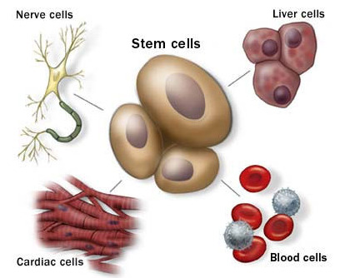
Genes store the information that defines how
  A cell behaves
  A cell functions
How is this information accessed?
How does this information determine how the cell functions?
http://imgarcade.com/
Genes encode the information on how to make a protein.
Proteins are the “workforce” of a cell.

Slide 6
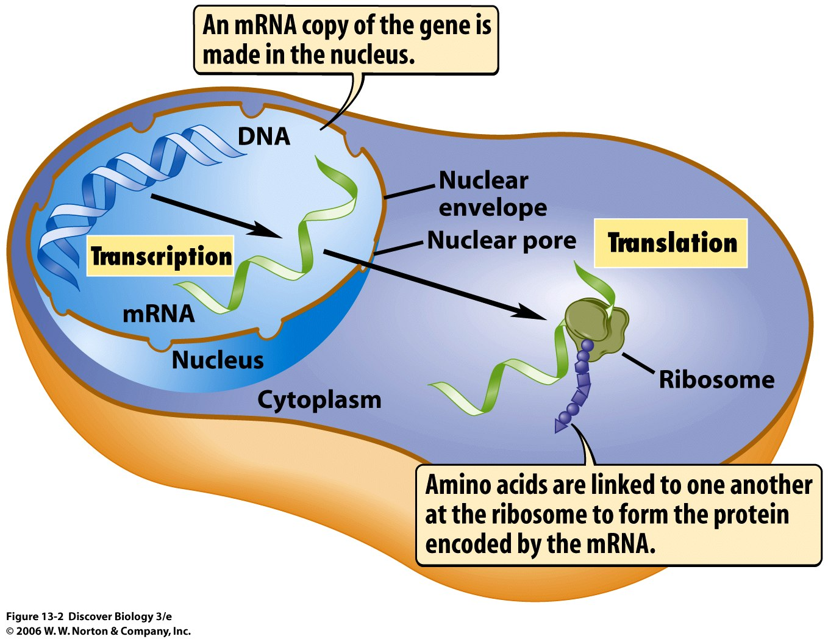
transcription
translation
DNA → mRNA →protein

Slide 7
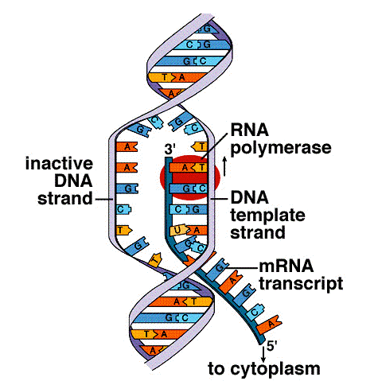
TRANSCRIPTION is the synthesis of RNA using DNA as the template.
deoxyribonucleic acid
(DNA)
Similar to DNA, RNA is made of nucleotides.
ribonucleic acid
(RNA)
http://www.expertsmind.com/
Notes:
This is a good moment to explain TRANSCRIPTION, and why it is called transcription. Not sure if the HS students will know the meaning of “to transcribe”. You can use examples such spoken words → written words (same information, same language). Or, transcription in music, rewriting a music piece for one instrument to another instrument using the same language (musical notes). Transcription, in this sense, is passing on the information in DNA to RNA using the “language” of nucleotides.

Slide 8
bases in DNA: adenine (A), guanine (G), cytosine (C), and thymine (T)
bases in RNA: adenine (A), guanine (G), cytosine (C), and uracil (U)
phosphate
base
sugar
nucleotide
A
T
C
G
T
G
DNA
base-pairing
during transcription
U
A
G
C
RNA
A
Notes:
Emphasize that in RNA there is no T, instead there is U. Pairing is, again, through hydrogen bonds (the same bonds that hold the two strands in DNA).

Slide 9
ACTIVITY #1
Transcription
Take back your DNA molecule.
Starting with the sequence T-G-A on your DNA molecule, transcribe your DNA.

Slide 10
Transcription is the first step of protein synthesis.
The type of RNA that results from this step is messenger RNA (mRNA). After RNA is made, it leaves the nucleus.
In the cytoplasm, ribosomes “read and translate” the message in mRNA to make the protein.
Notes:
messengerRNA because it carries a MESSAGE. There are other types of RNA in the cell. Describe the ribosome as a “machine” or a “decoder” that reads the information and translates it. Use an analogy: Barcodes → Price. Start using the word “code”.

Slide 11
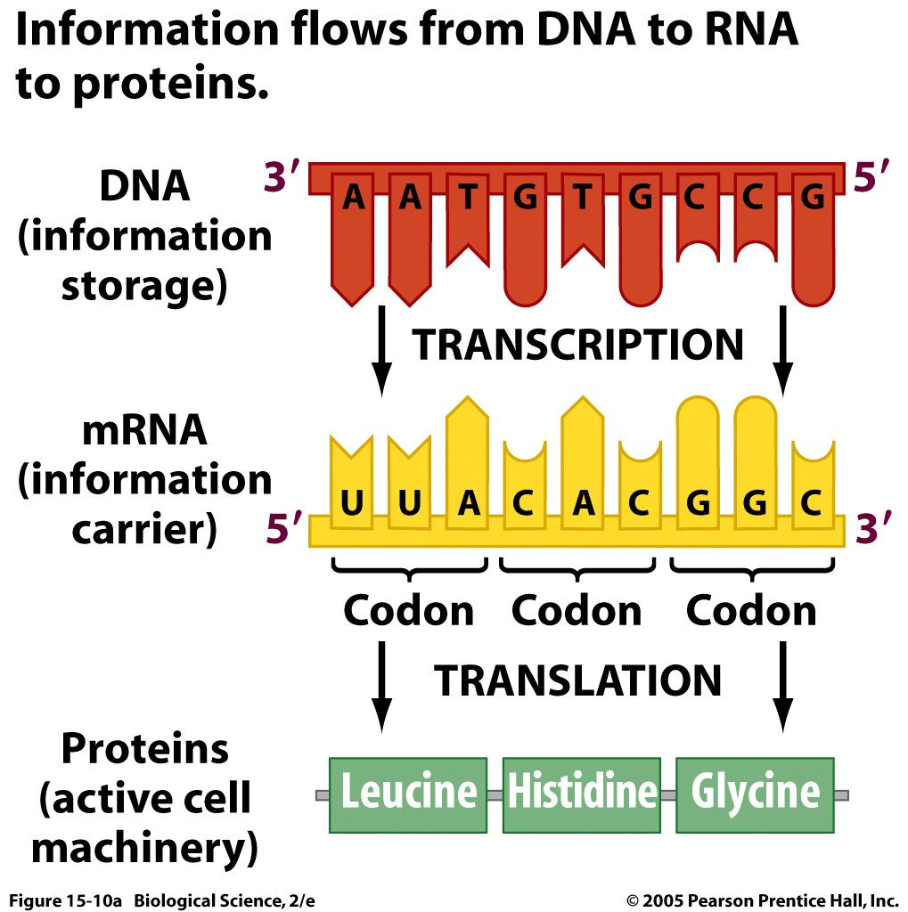
TRANSLATION is the synthesis of a protein using the information (message, code) in mRNA.
PROTEINS
(active cell machinery)
Notes:
Again, explain, compare/contrast TRANSCRIPTION with TRANSLATION.

Slide 12
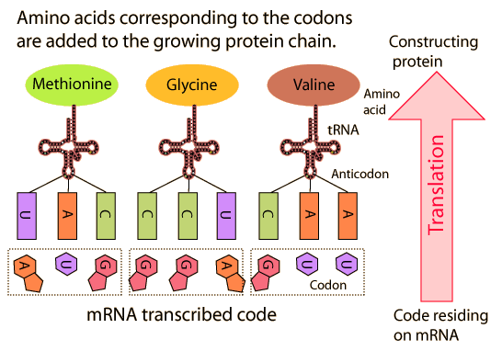
Amino acids corresponding to the codons are added to the growing protein chain.
http://hyperphysics.phy-astr.gsu.edu/
Notes:
This slide is animated. Explain that “amino acids” are the “building blocks” of proteins (proteins are made of amino acids). Just mention that tRNA (transfer RNA) is the RNA that brings (“transfers”) an amino acid. The tRNA has a “triplet” that compliments that one in the mRNA, so that the code that was in the DNA is retained. Thus, the information that was in DNA is transcribed to RNA, and then translated to a protein (in amino acids, not in nucleotides).

Slide 13
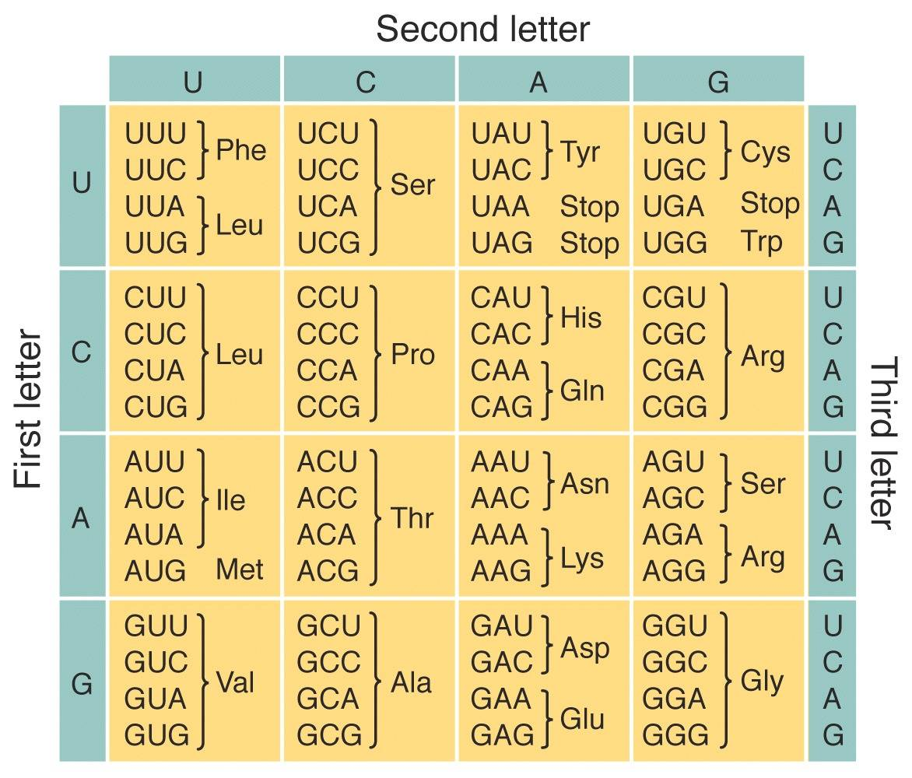
The genetic code is a set of “rules” by which the information in mRNA is translated into proteins.
A codon is made of three nucleotide bases (triplet) and it may translate into:
  an amino acid,
  a “start” signal (which is always the amino acid Met),
or
  a “stop” signal (no amino acid)
http://www.geek.com/
Notes:
Explain the words codon and triplets. Show them how to use the code. You may need to use the board. Write two triplets, translate the first one, ask them to translate the second one. Just mention (don’t explain too much) that amino acids have the full name, three letter abbreviation, and a one letter abbreviation.

Slide 14
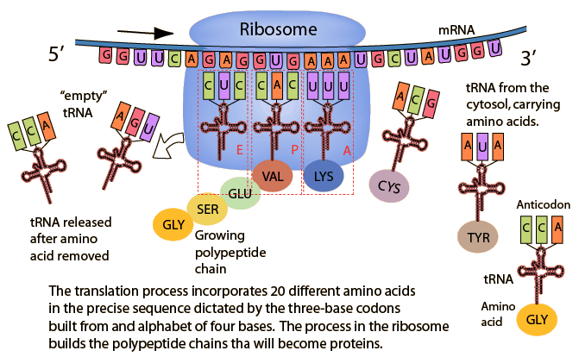
http://hyperphysics.phy-astr.gsu.edu/
Notes:
Not sure if this slide is needed. But here they can visualize what happens in the ribosome. Guide them step by step, from RIGHT to LEFT (tRNA+amino acid) coming, binding with the mRNA, connecting the amino acids, and then discarding the “empty tRNA”.

Slide 15
ACTIVITY #2
Translation
Translate your RNA molecule!

Slide 16
What would happen if this nucleotide (C) changes?
http://www.cstephenmurray.com/
Notes:
Errors can happen. DNA can get damaged and change one or more nucleotide in a DNA (gene) sequence.

Slide 17
A mutation is a change in the nucleotide sequence of a gene.
Mutations occur at the DNA level, and then carried over to the mRNA during transcription.
-Ala-Asp-Leu-Ala
substitution
insertion
deletion
Leu
Leu
Leu
A
A
Ala→Glu mutation
changes the grouping of triplets
changes the grouping of triplets
Notes:
Explain each type of mutation clearly, especially the concept of shifting the “reading frame” (but don’t use those words). Just make them see and understand the implication of inserting and deleting one nucleotide. The main thing they need to understand is the substitution, because sickle cell arises from a substitution.

Slide 18
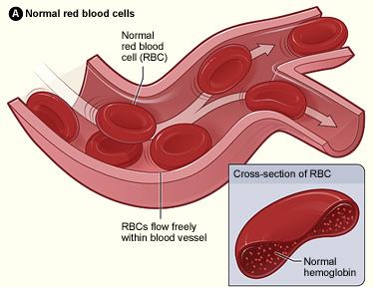
SICKLE-CELL ANEMIA IS A GENETIC DISEASE
NORMAL CELL
MUTATION
SICKLE-CELL
https://en.wikipedia.org
SICKLE-CELL ANEMIA ARISES FROM A MUTATION IN HEMOGLOBIN

Slide 19
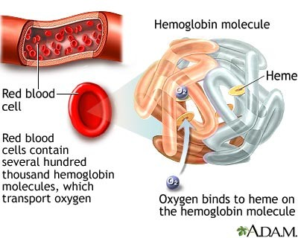
Hemoglobin is a protein found in red blood cells that carries oxygen throughout the body.
http://www.nytimes.com
Notes:
Hemoglobin is a protein. Therefore, when cells make hemoglobin, the DNA “encoding” hemoglobin is transcribed in the nucleus. Then translated by the ribosome in the cytoplasm. In sickle cell, there is mutation in the DNA encoding hemoglobin, which results in the production of a protein that cannot do its job (carry oxygen) properly.

Slide 20
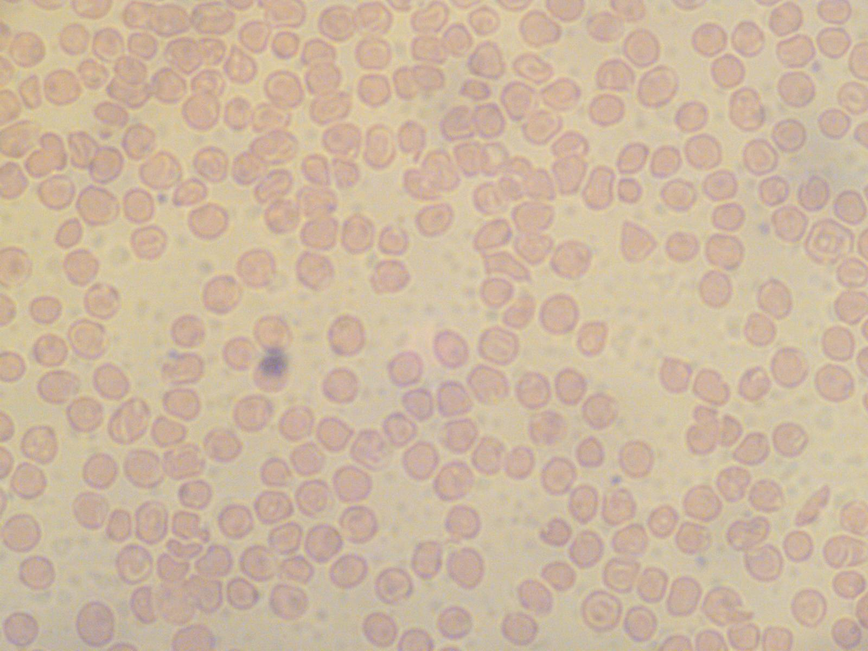
normal cell showing the concave shape
normal
sickle

Slide 21
ACTIVITY #3
Mutation and Sickle Cells

