Slide 1
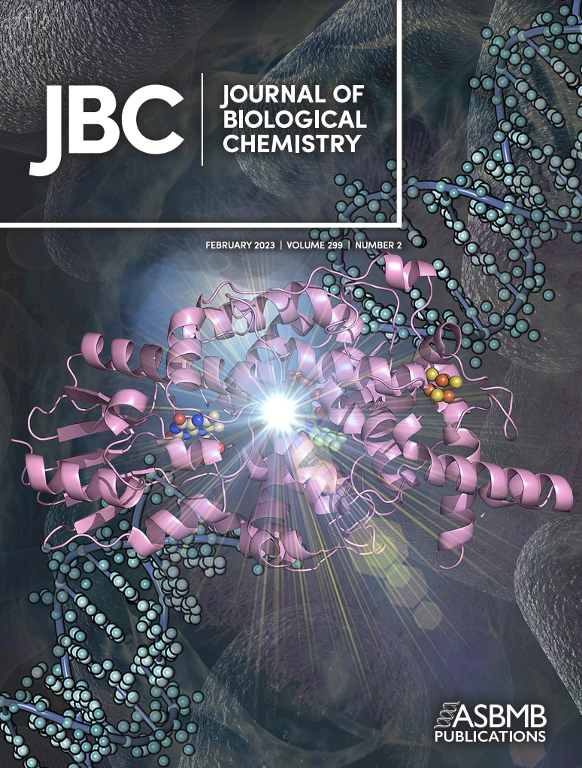
Why Publish in the JBC?
Sets the standard: high quality, enduring discoveries
For scientists, by scientists! Rigorous review by over 600 editorial board members
Fully gold open access
Rapid Review: Time to first decision 2.5 weeks
Value! $2,300 APC for ASBMB members ($2,800 for non members)
ECR Program: training the next generation
Data Integrity: Increasing transparency, rigor and reproducibility
Owned by ASBMB: your voice is amplified by supporting a society that actively advocates for science
Want to learn more?www.jbc.org atoker@asbmb.org

