Slide 1


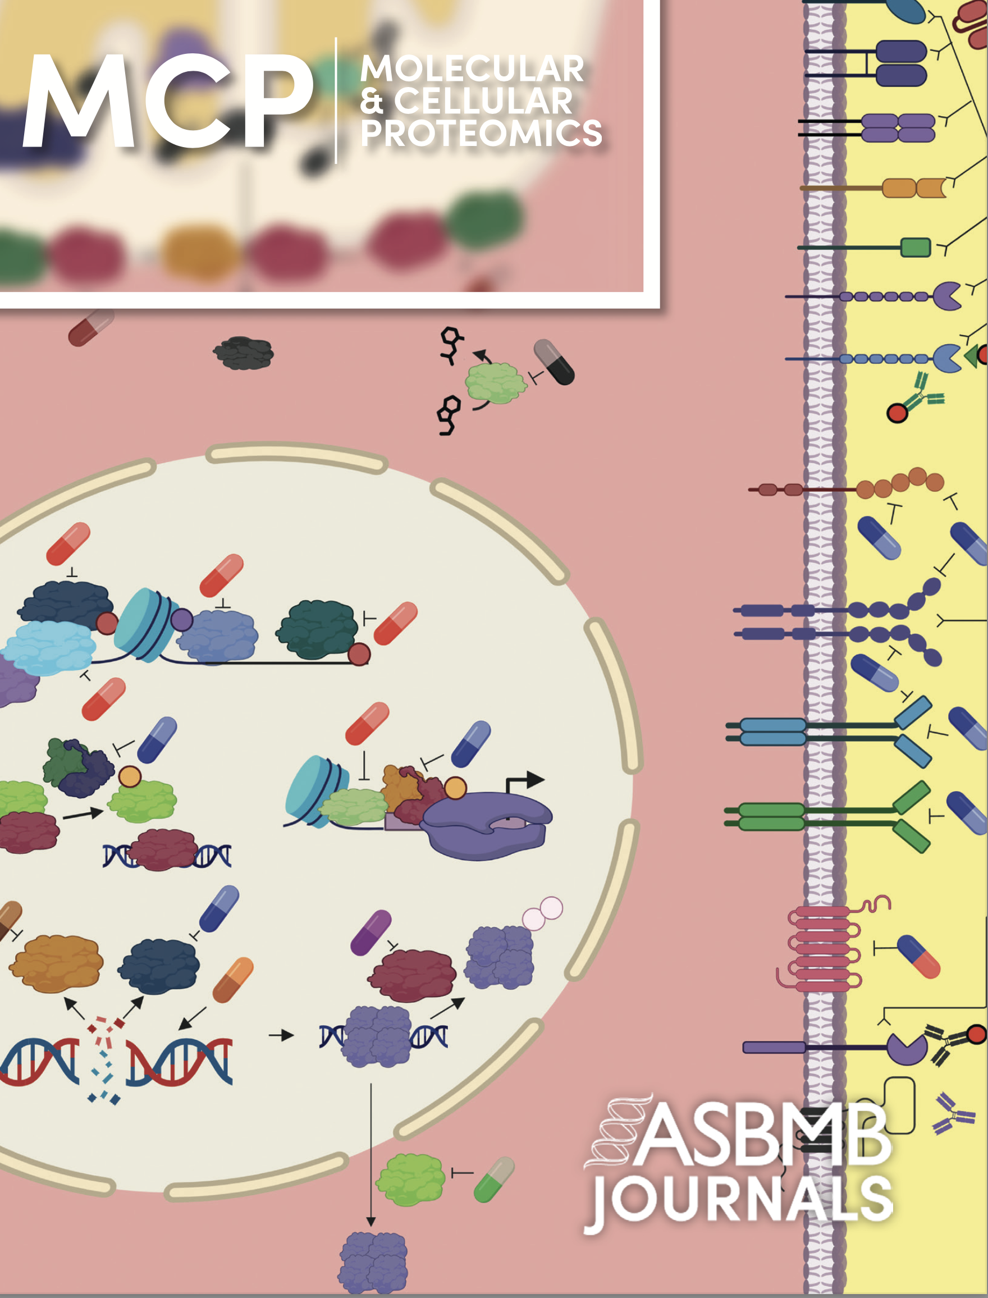
Why Publish in MCP?
Want to learn more? www.mcponline.org
Sets the standard: High-quality mass spectrometry and proteomics research
Data integrity: Increasing transparency, rigor and reproducibility
For scientists, by scientists! Rigorous review by over 100 editorial board members
Fully gold open access
Value! $2,300 APC for ASBMB members ($2,800 for nonmembers)
Owned by the ASBMB: Your voice is amplified by supporting a society that actively advocates for science
For more information - mcpsubmission@asbmb.org

