Slide 1
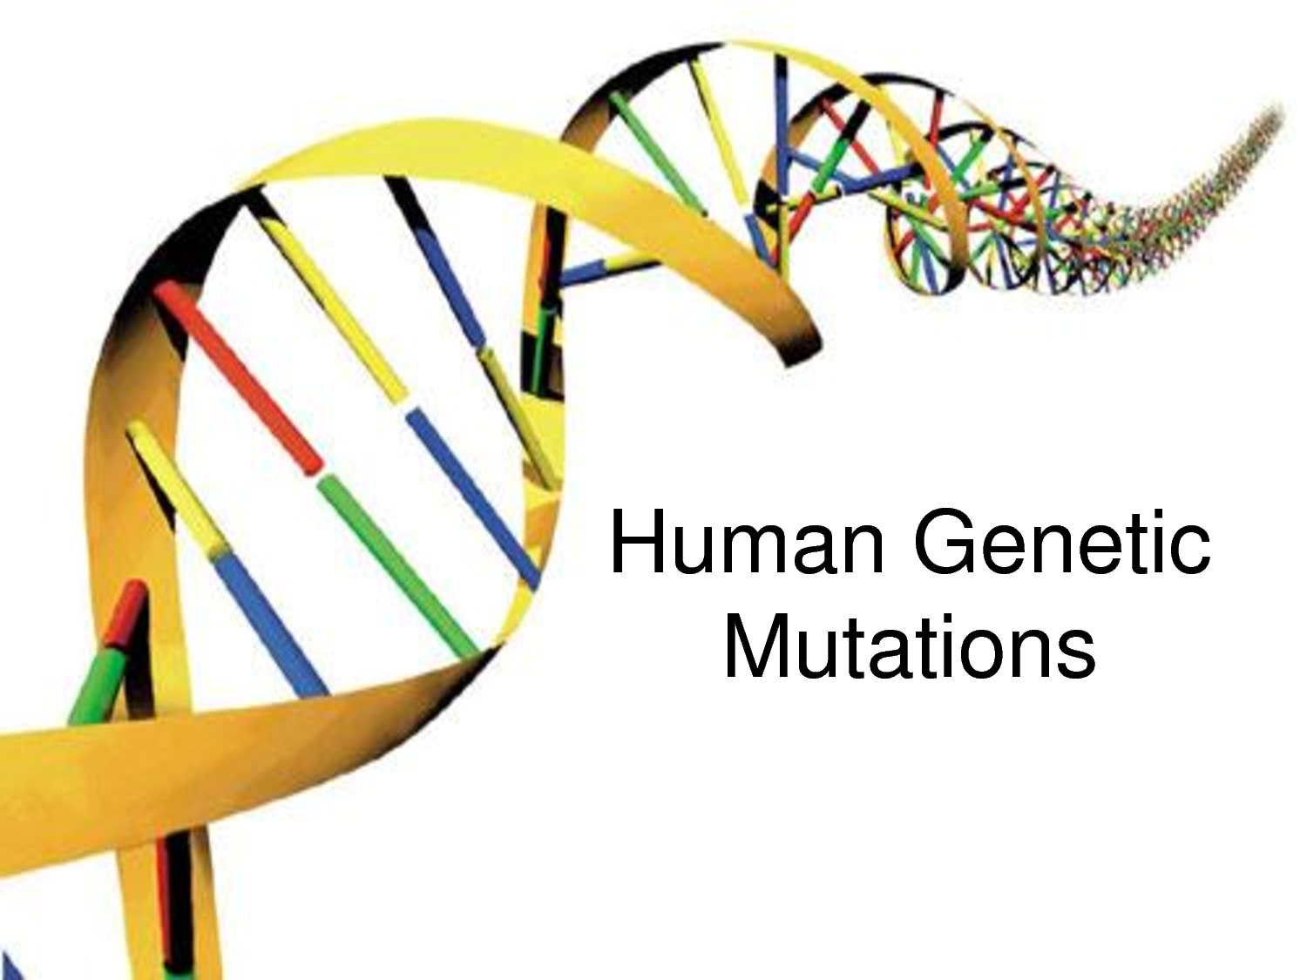
GENES, MUTATIONS & DISEASES:
UNDERSTANDING THE ORIGINS OF GENETIC DISORDERS
http://www.raogk.org/dna/

Slide 2
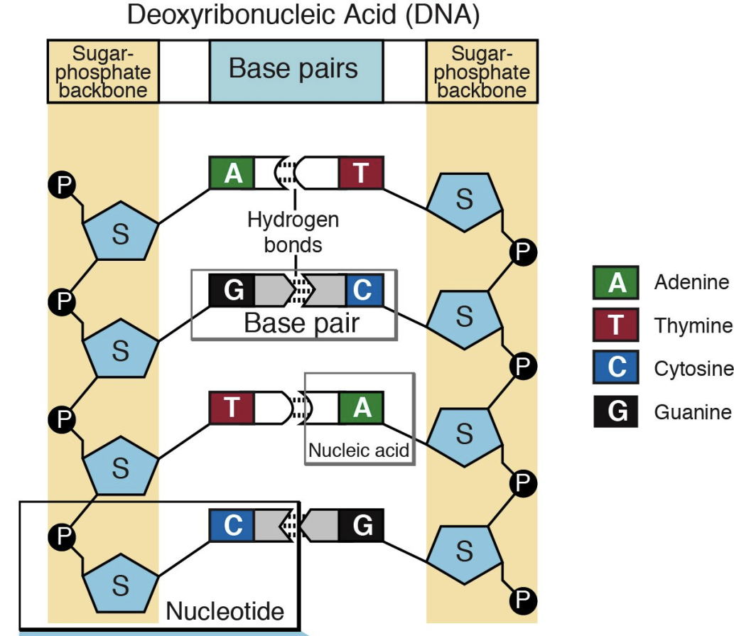
PREVIOUSLY…
Nucleotides, DNA, and Genes
http://igbiologyy.blogspot.com/
http://knowgenetics.org/
Notes:
Briefly, review the main concepts from the last lesson. Start with reminding them the goal of the program: to understand genetic diseases using the example of sickle cell. Then, remind them what genes and DNA are. They need to be reminded of nucleotides and hydrogen bonding because they will see them again in RNA.

Slide 3
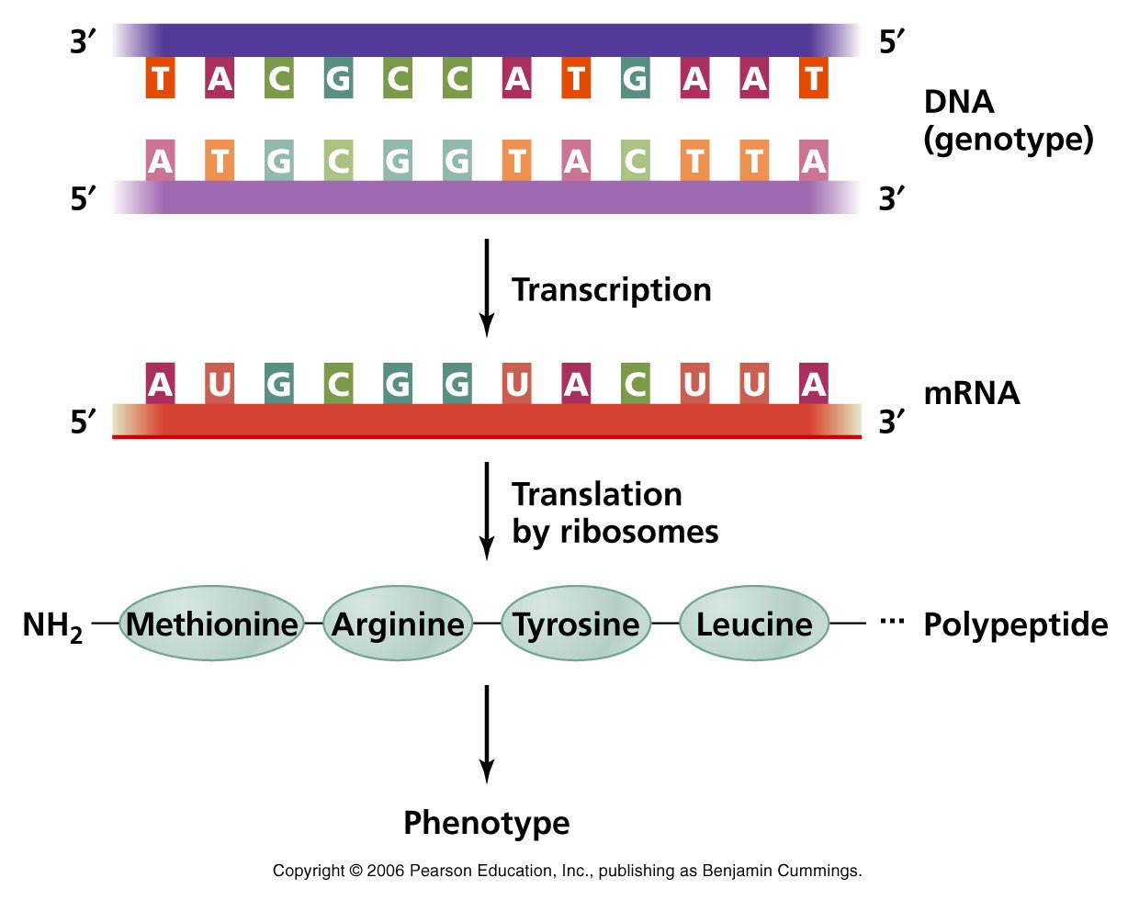
PREVIOUSLY…
PROTEINS
(active cell machinery)

Slide 4
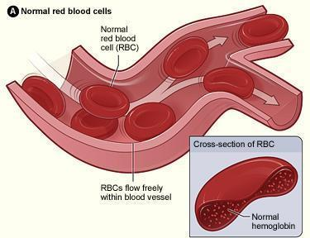
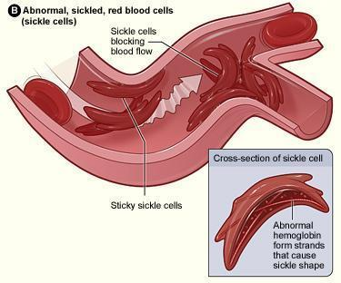
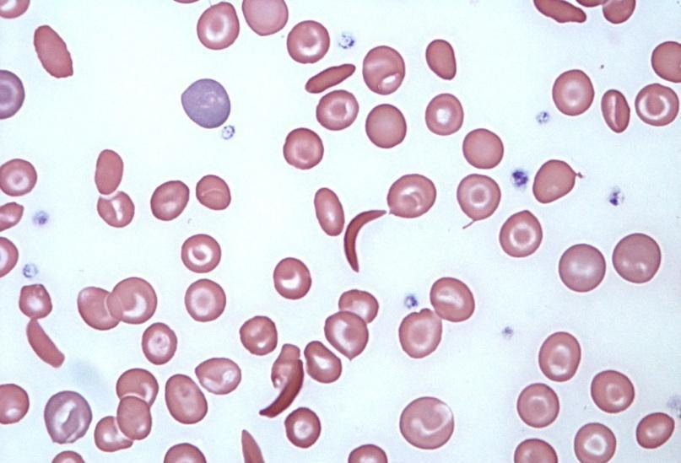
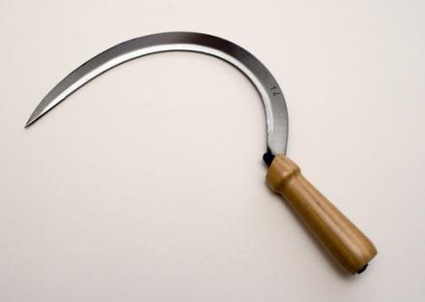
OUR GOAL: to understand sickle cell
https://en.wikipedia.org
a sickle

Slide 5
LESSON #3

Slide 6
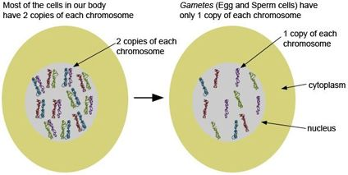
SOMATIC CELLS
GAMETES (SEX CELLS)
23 CHROMOSOMES
HAPLOID
23 PAIRS OF CHROMOSOMES
(46 CHROMOSOMES)
DIPLOID
http://64.40.115.136.van.ca.siteprotect.com/

Slide 7
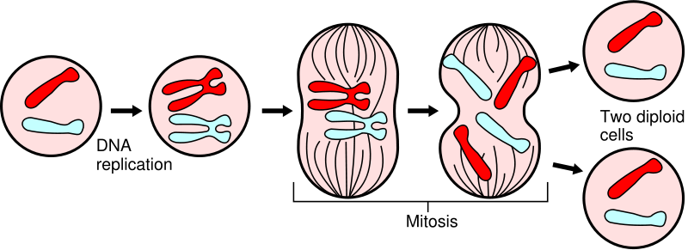
MITOSIS
23 PAIRS IN HUMANS
diploid
https://oikos2011.wordpress.com
Notes:
Mitosis is the process by which an animal cell, which has previously replicated each of its chromosomes, separates the chromosomes in its cell nucleus into two identical sets of chromosomes, each set in its own new nucleus.

Slide 8
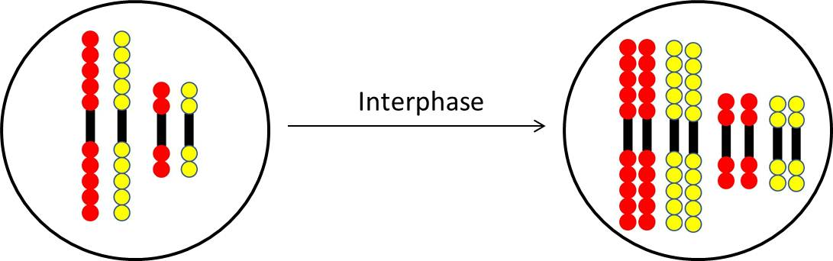
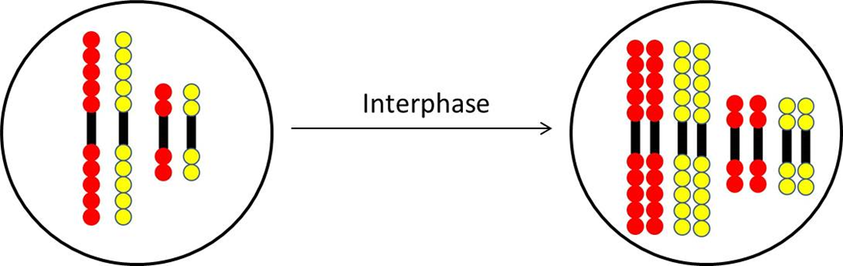
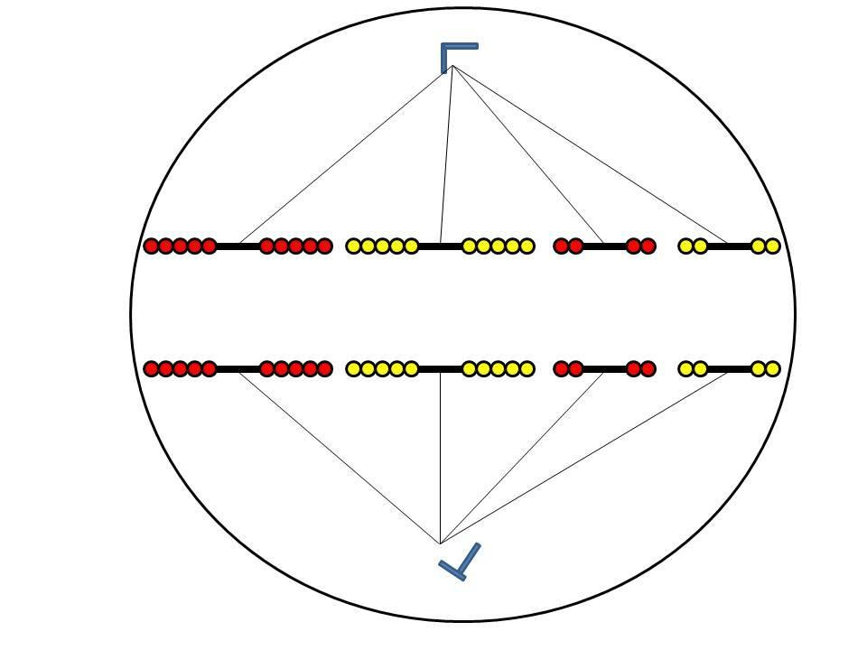
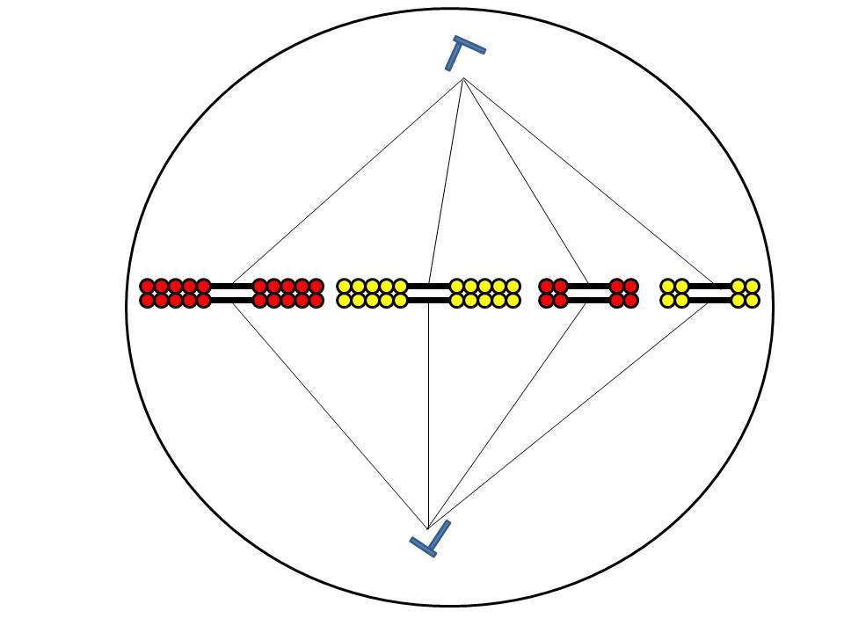
Mitosis:
METAPHASE ANAPHASE TELOPHASE

Slide 9
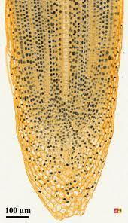
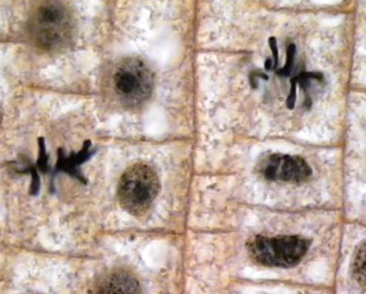
ACTIVITY #1
MITOSIS
In plants, roots continue to grow as they search for water and nutrients.
These regions of growth are useful for studying mitosis because at any given time, you can find cells that are undergoing mitosis.
http://galleryhip.com/
  Can you identify cells in each stage of mitosis?
http://cherlyncreative2biology.blogspot.com/

Slide 10
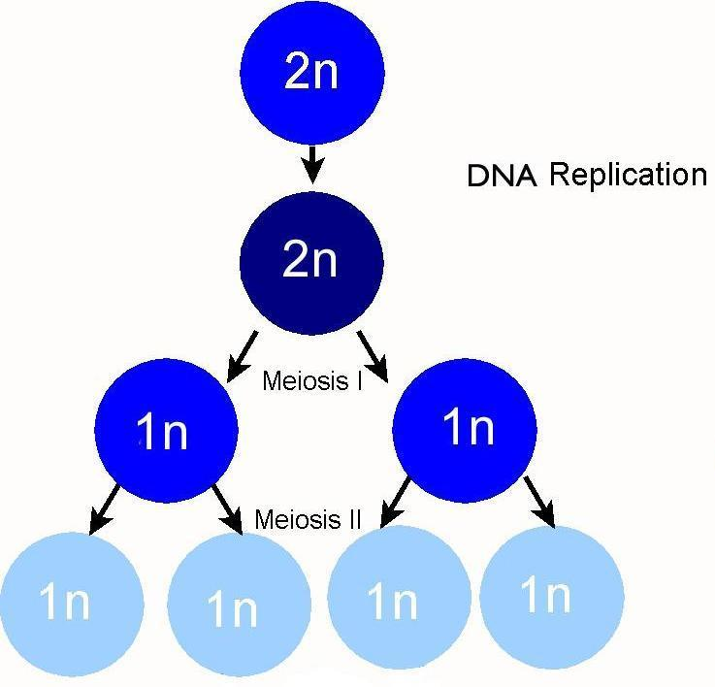
MEIOSIS
diploid
Sex cells are produced by meiosis.
In humans, meiosis reduces the number of chromosomes from 46 (23 pairs) to 23 (single).
in humans
n = 23
haploid
http://bio.rutgers.edu/

Slide 11
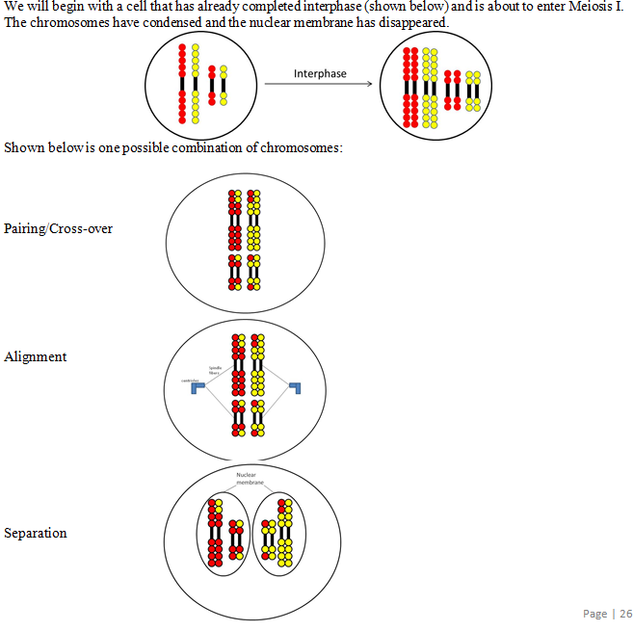
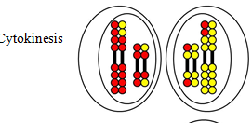
Meiosis I:

Slide 12
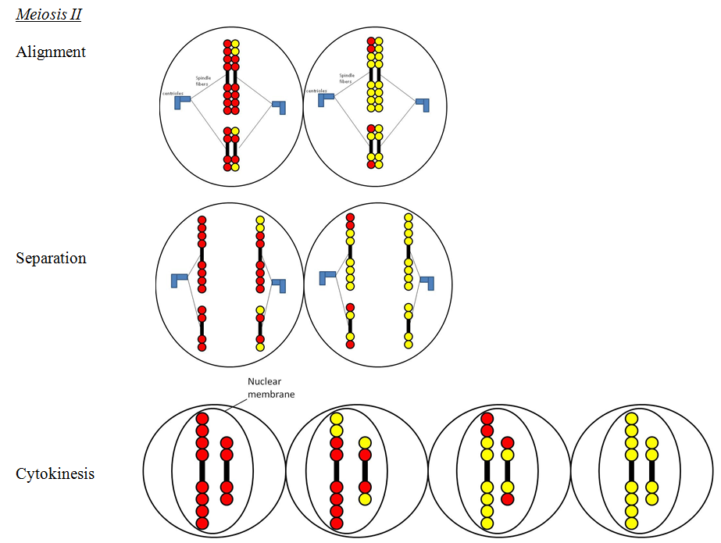
Meiosis II:

Slide 13
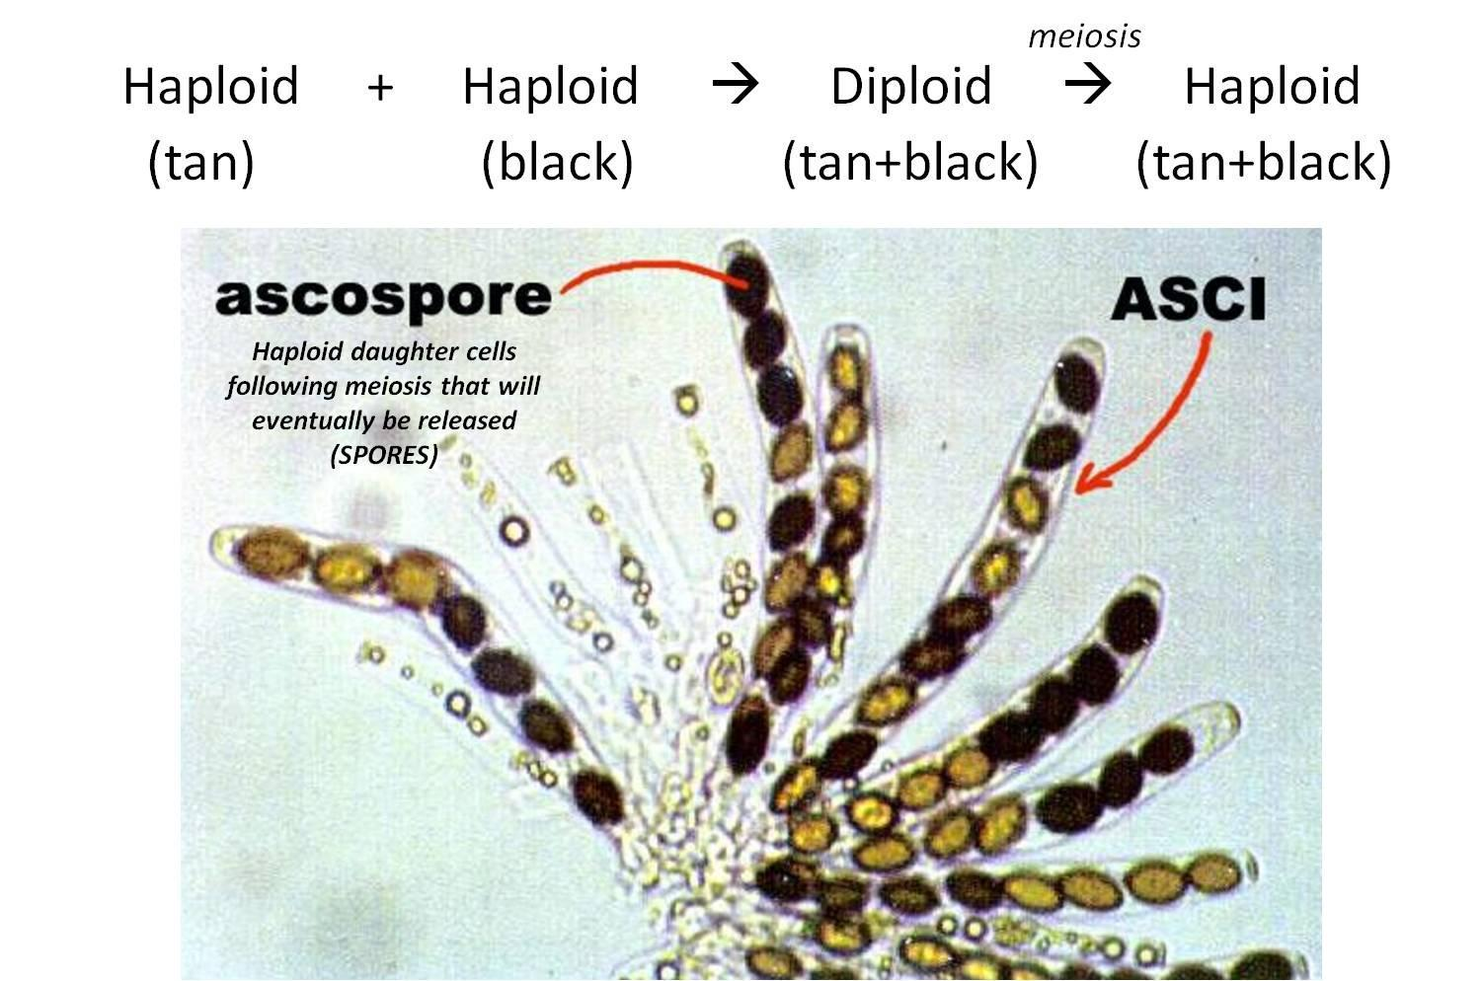
ACTIVITY #2
MEIOSIS
http://www.powershow.com/

Slide 14
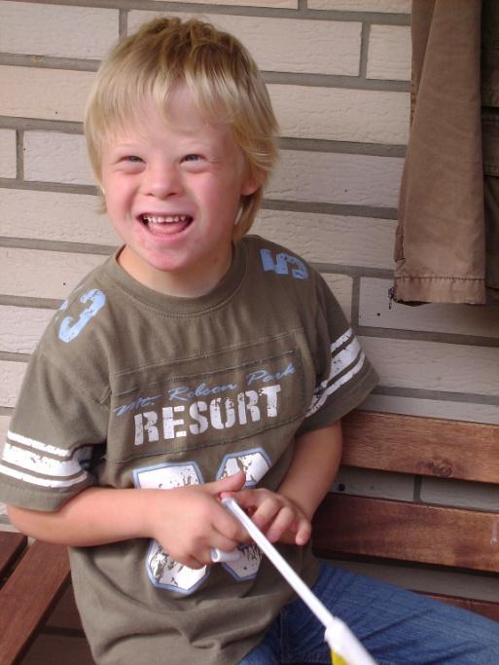
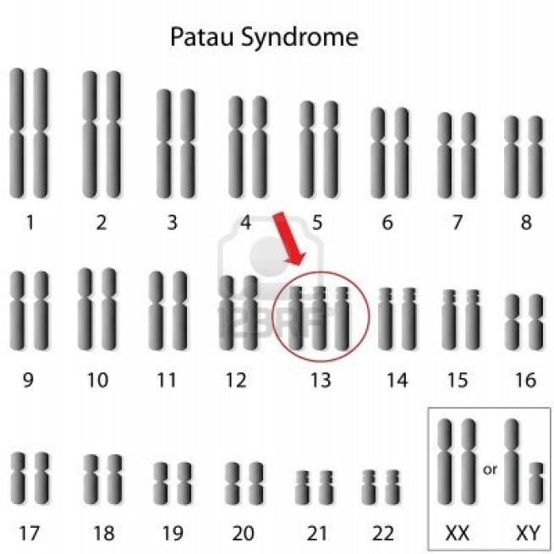
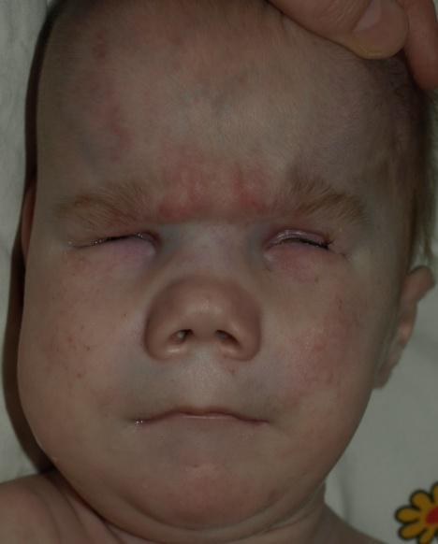
Errors in meiosis can occur
Down Syndrome – Trisomy 21
Patau Syndrome – Trisomy 13
http://imgkid.com/
Notes:
NOTE: Sickle-cell disease is not because an abnormal number of chromosomes (not because “error” in meiosis).

Slide 15
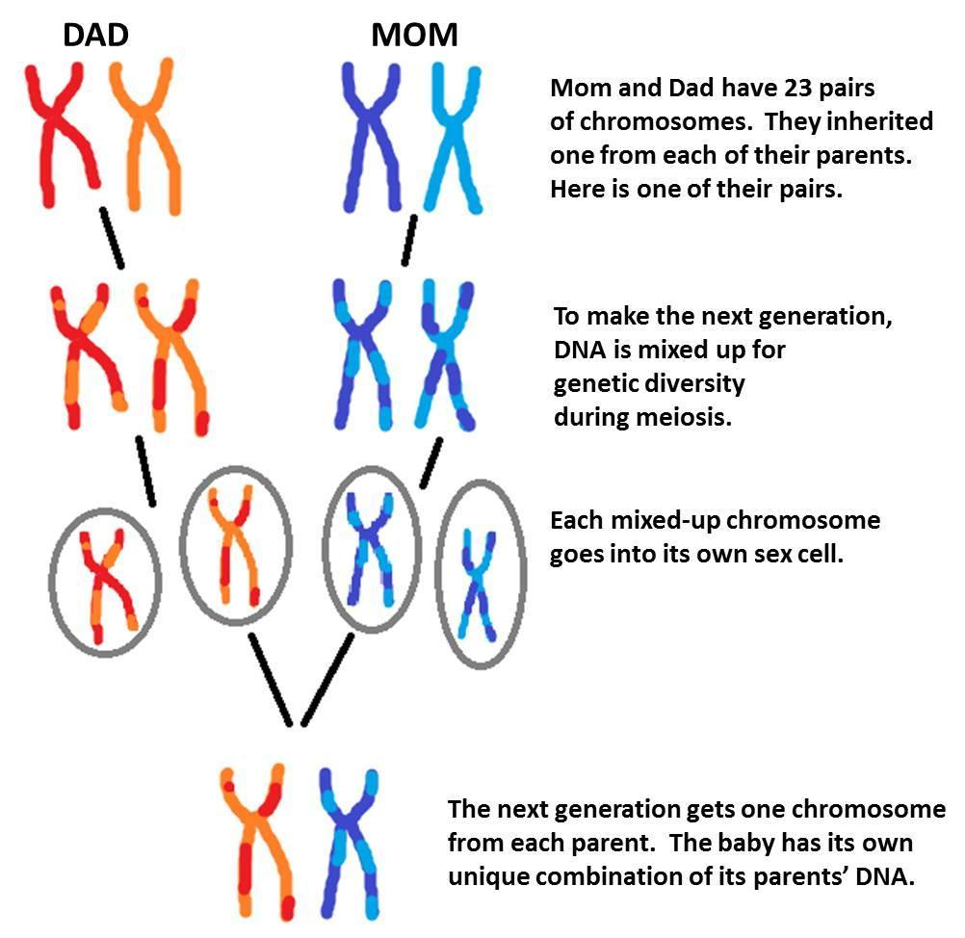
INHERITANCE AND GENETIC DIVERSITY
diploid
haploid
diploid

Slide 16
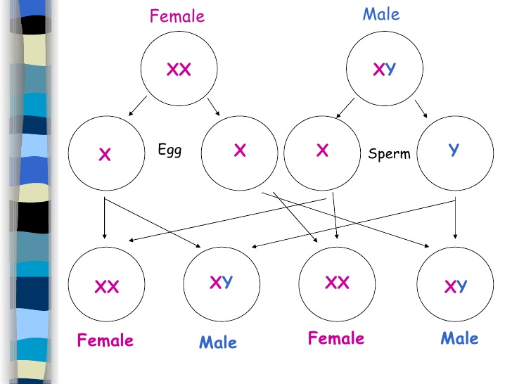
egg-producing
cell
sperm-producing
cell
MEIOSIS
FERTILIZATION
FERTILIZED
EGGS
http://www.slideshare.net/rossbiology
Notes:
During reproduction, gametes fuse together to form a diploid organism. Unfortunately, errors in meiosis can occur, resulting in several genetic disorders.

Slide 17
GENETIC DIVERSITY
Homologous chromosomes are chromosome pairs with genes for the same characteristic.
An allele is one of the alternative forms of the same gene.

Slide 18

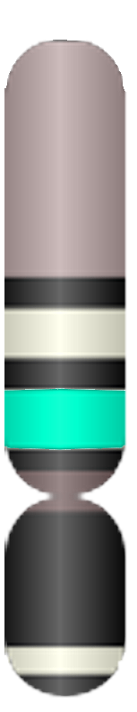
GENOTYPE:
A
A
A
O
O
O
homozygous
heterozygous
homozygous
PHENOTYPE:
(BLOOD TYPE)
A
A
O
allele A is DOMINANT
allele O is RECESSIVE

Slide 19
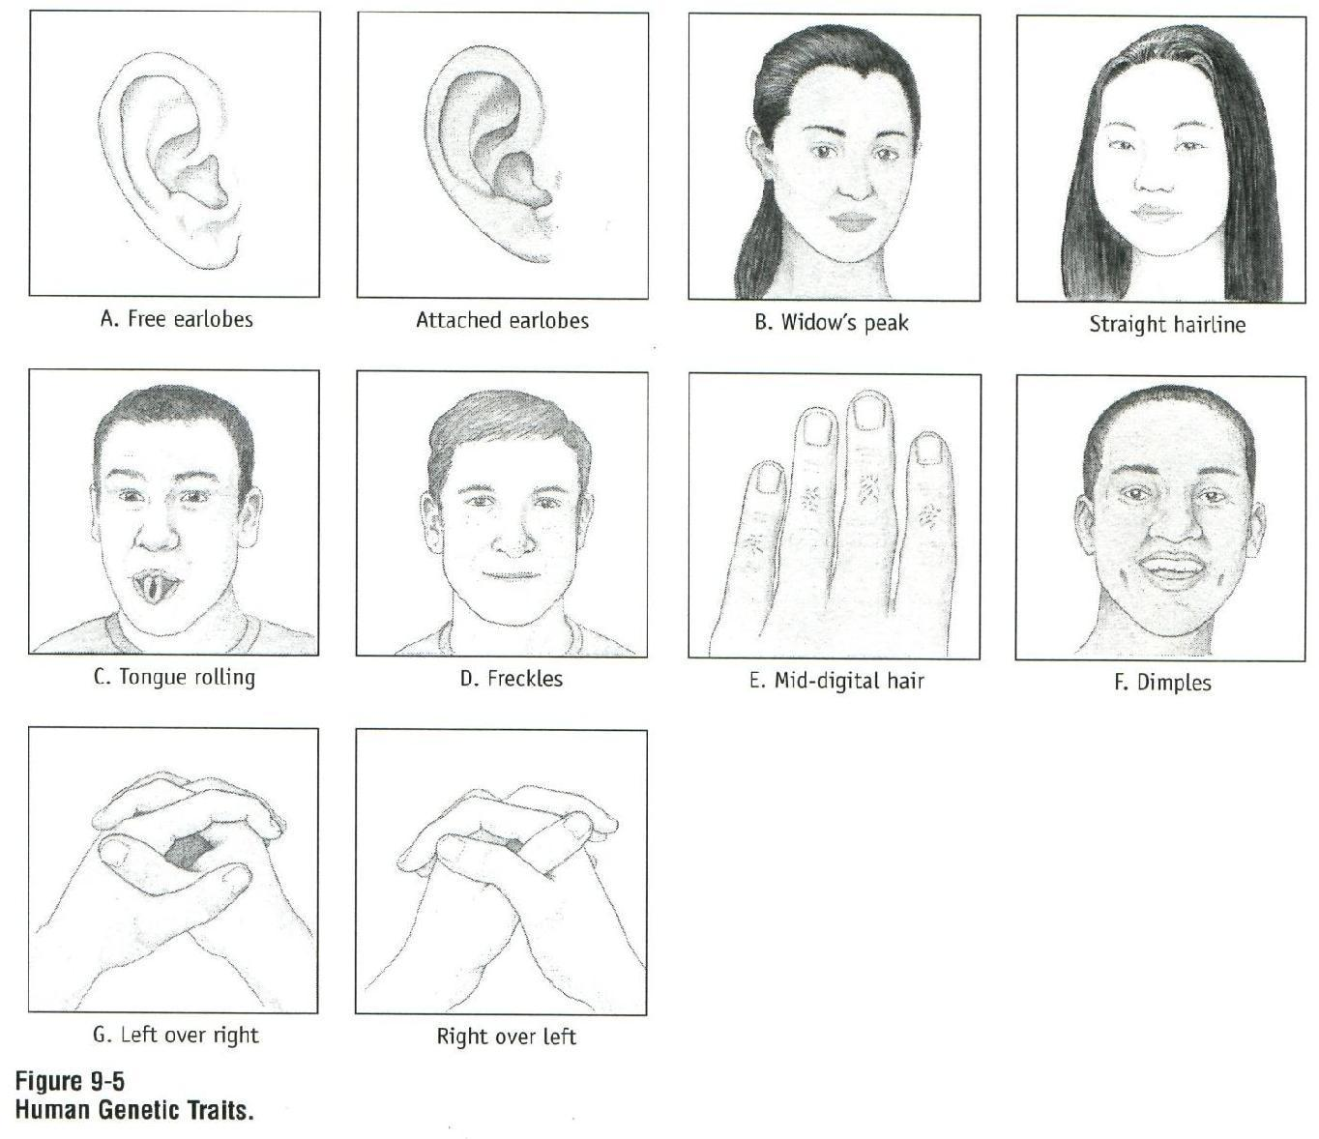
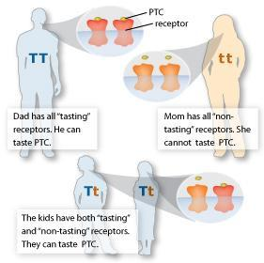
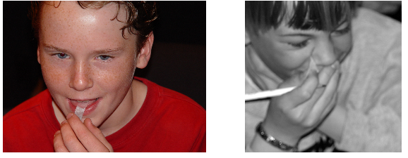
ACTIVITY #3
PHENOTYPES
http://learn.genetics.utah.edu/
PTC non-taster PTC taster
Cengage Learning Asking About Life Lab Manual
Does the class exhibit the dominant phenotypes?

Slide 20
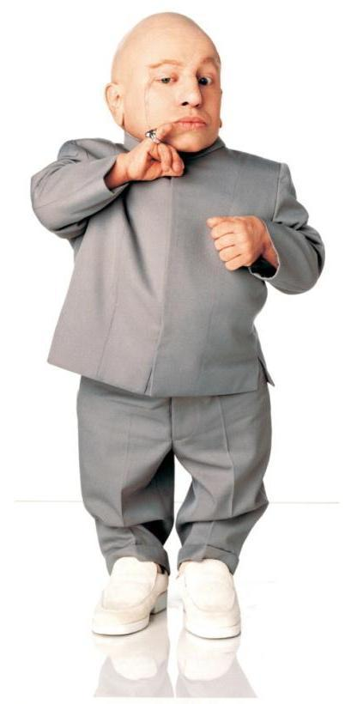
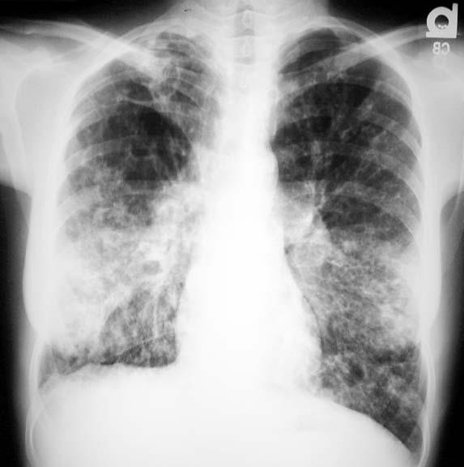
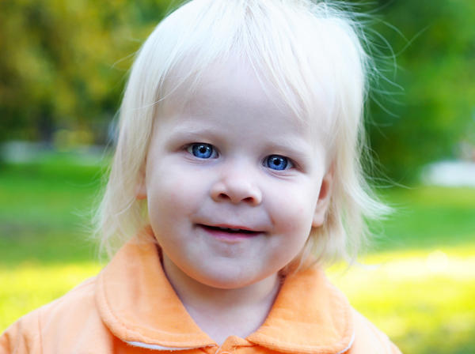
Genetic disorders are caused by one or more abnormalities in one or more genes.
CYSTIC FIBROSIS
ALBINISM
DWARFISM
recessive
chromosome 7
recessive
chromosome 11
dominant
chromosome 4
http://www.doctortipster.com/
http://diseasespictures.com/
Notes:
Hopefully they have heard of some of these four diseases. Introduce them briefly.
Genetic diseases are inherited, not like “other” diseases (flu, HIV, cholera, etc.).
Goal: understand genetic diseases.

Slide 21
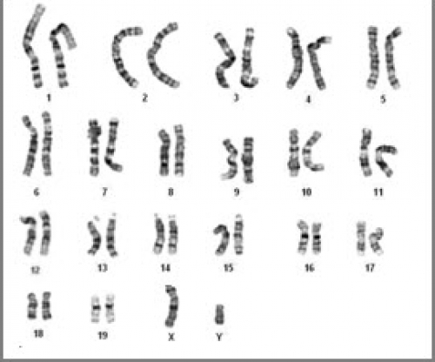
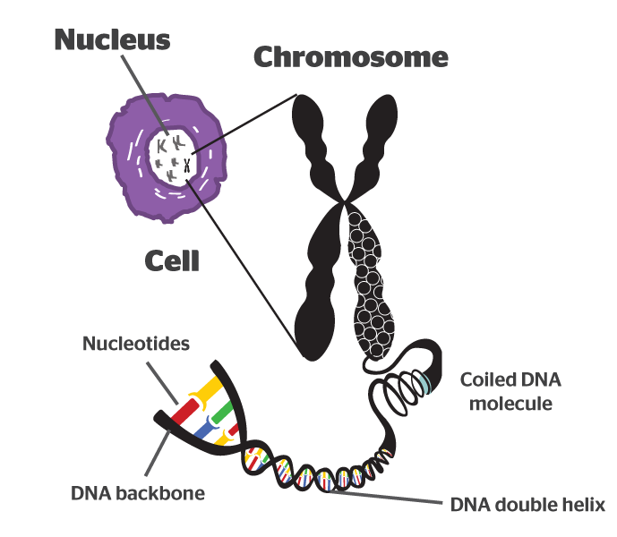
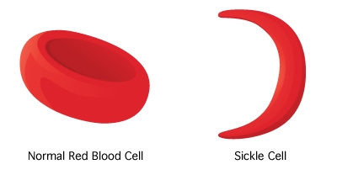
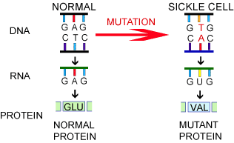
Sickle cell is a recessive disorder. A mutation occurs in an allele found in chromosome 11.
https://quantumtunnel.wordpress.com
http://www.globalstem.com/
http://hcbb.com/
http://igbiologyy.blogspot.com/
Notes:
Re-explain what “recessive disorder” means. This means that to develop the disease (phenotype of sickle cell), you need the mutation in both alleles obtained from the mother and the father.
Then, try to “put everything together”, lesson 1, lesson 2 and today’s lesson as a summary of what they have learned so far: “We have 23 pair of chromosomes…Chromosomes are…genes are…gene/DNA to RNA to protein….Mutations can occur…May lead to a “defective” protein…etc.”

