Slide 1


Slide 2
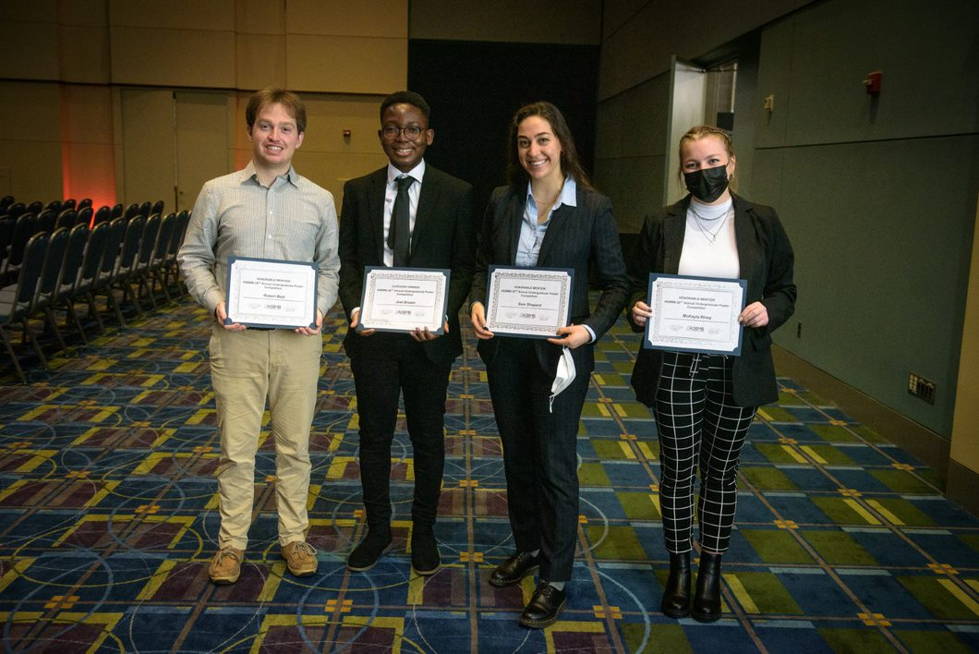
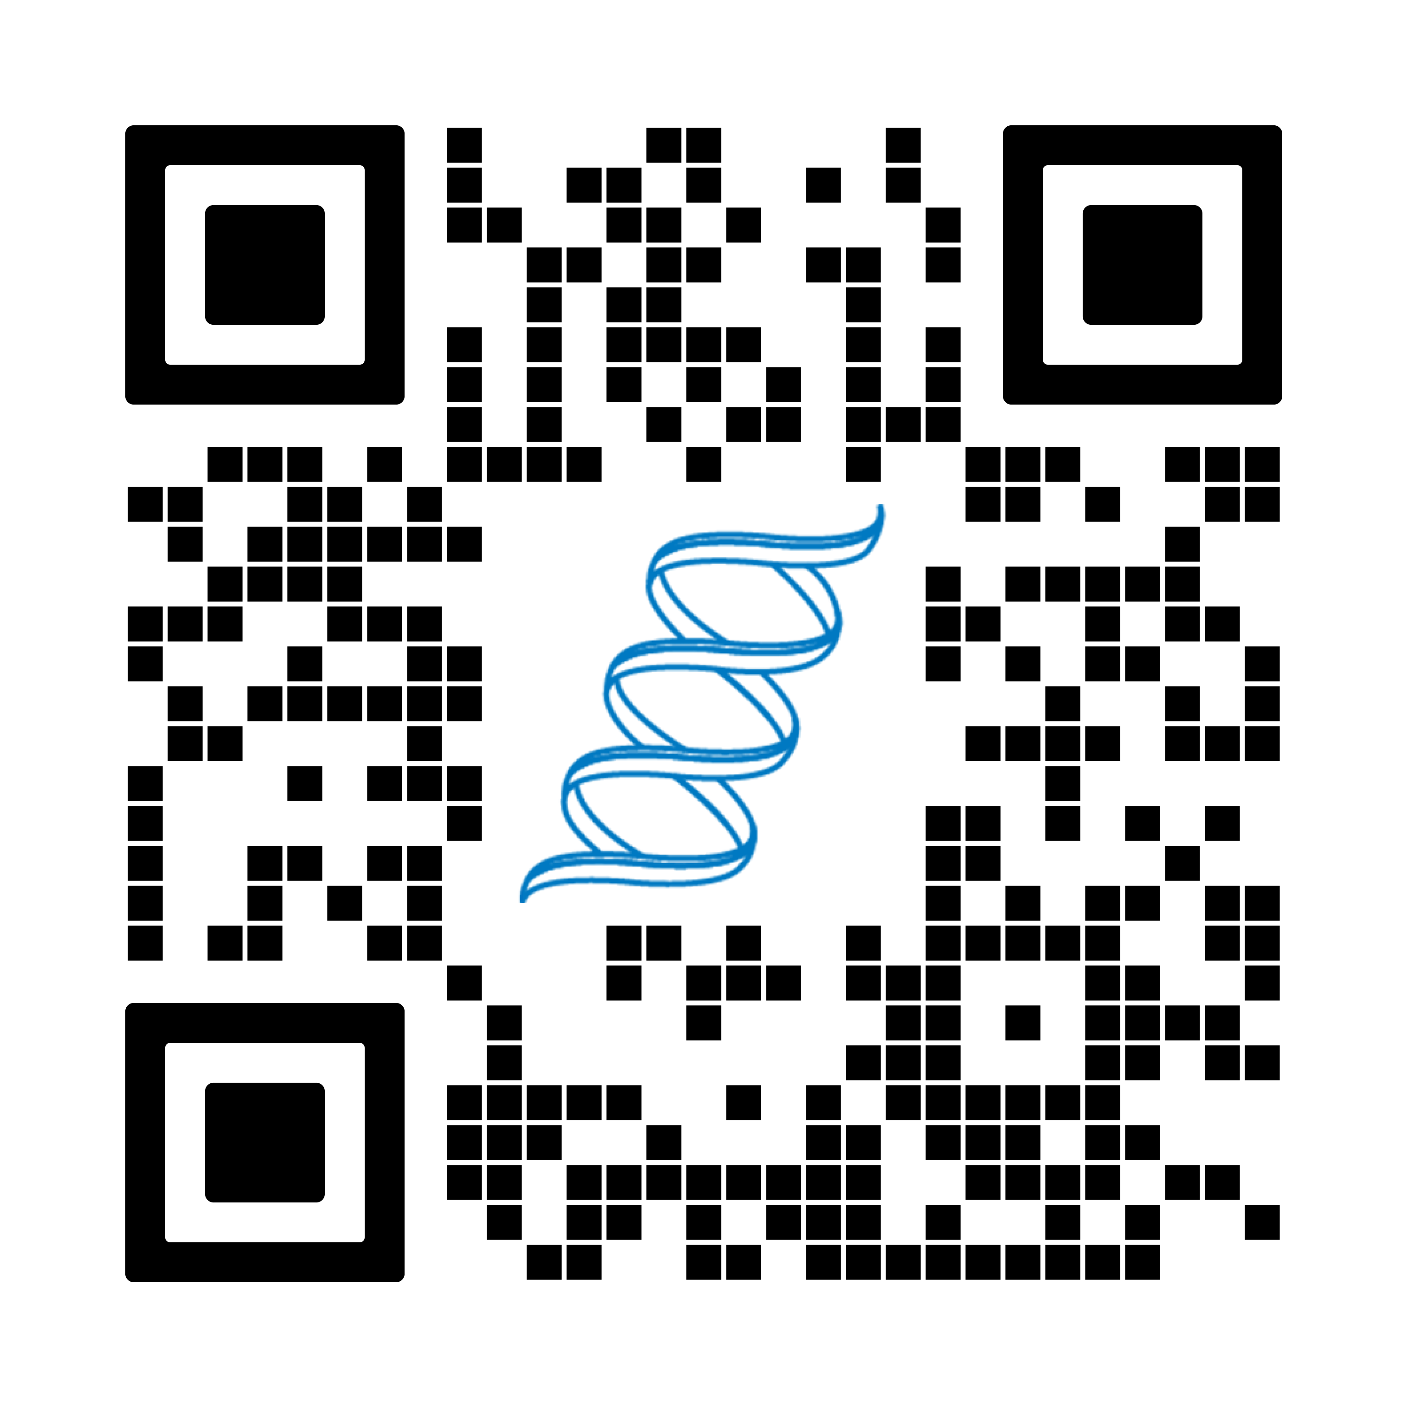
What is the ASBMB?
The American Society for Biochemistry and Molecular Biology
is a diverse community of biochemists and molecular life scientists.
Together, we’ll continue to advocate for science, connect researchers around the world and build a sustainable future.
Notes:
an international nonprofit scientific and educational organization. With over 11,000 members, made up of students, researchers, educators and industry professionals, the ASBMB is one of the largest molecular life science societies in the world (Photo shows undergraduate students recognized for their presentations at the Undergraduate Poster Competition held yearly at the annual meeting)

Slide 3
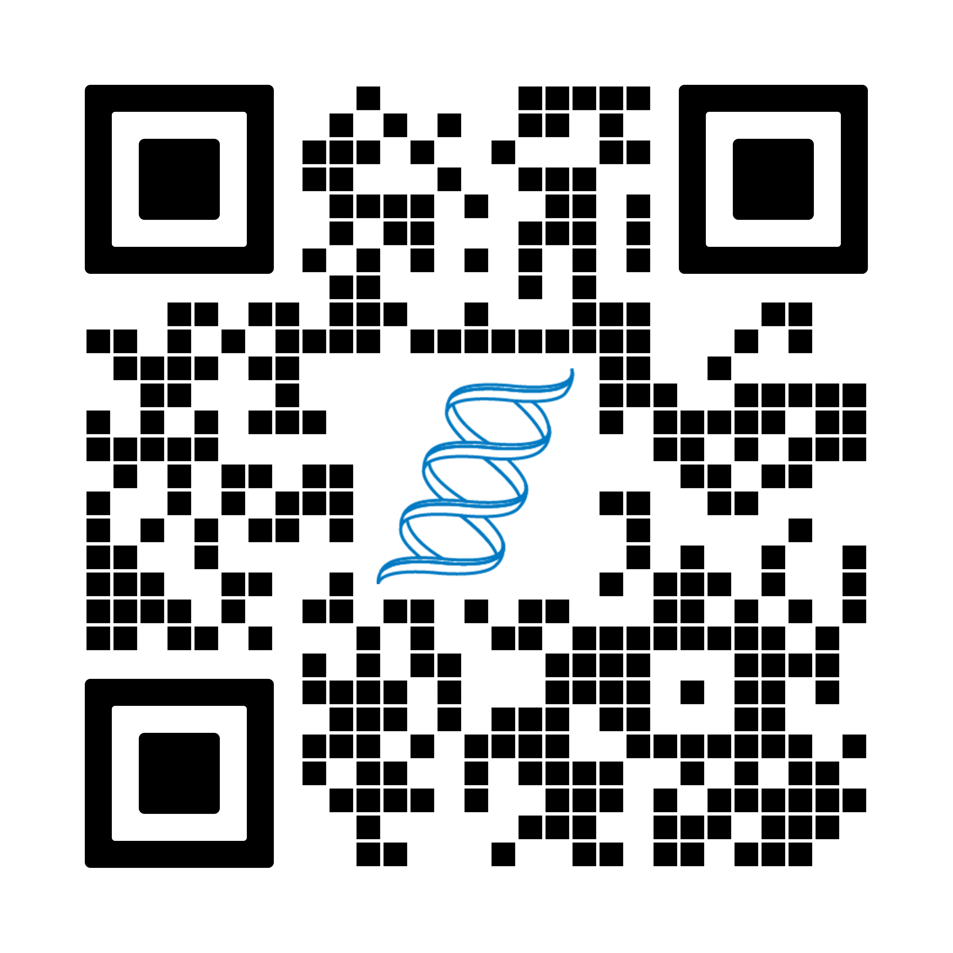
Congratulations on your [accomplishment]! Your career development never ends. What’s next?
Manage
your lab
Earn awards
The ASBMB will be a partner in your professional development at every step of your journey
Communicate your science
Learn to
write grants
Grow your molecular life science network
Advocate for science
The ASBMB is here to help you reach your career goals
Notes:
Will include info. from road maps on website once complete: https://www.asbmb.org/membership

Slide 4
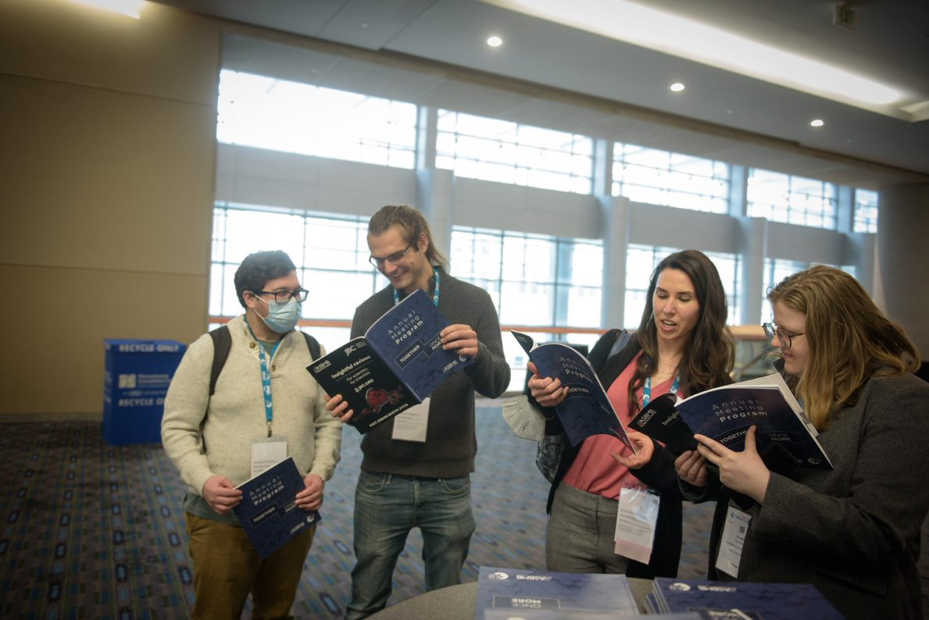
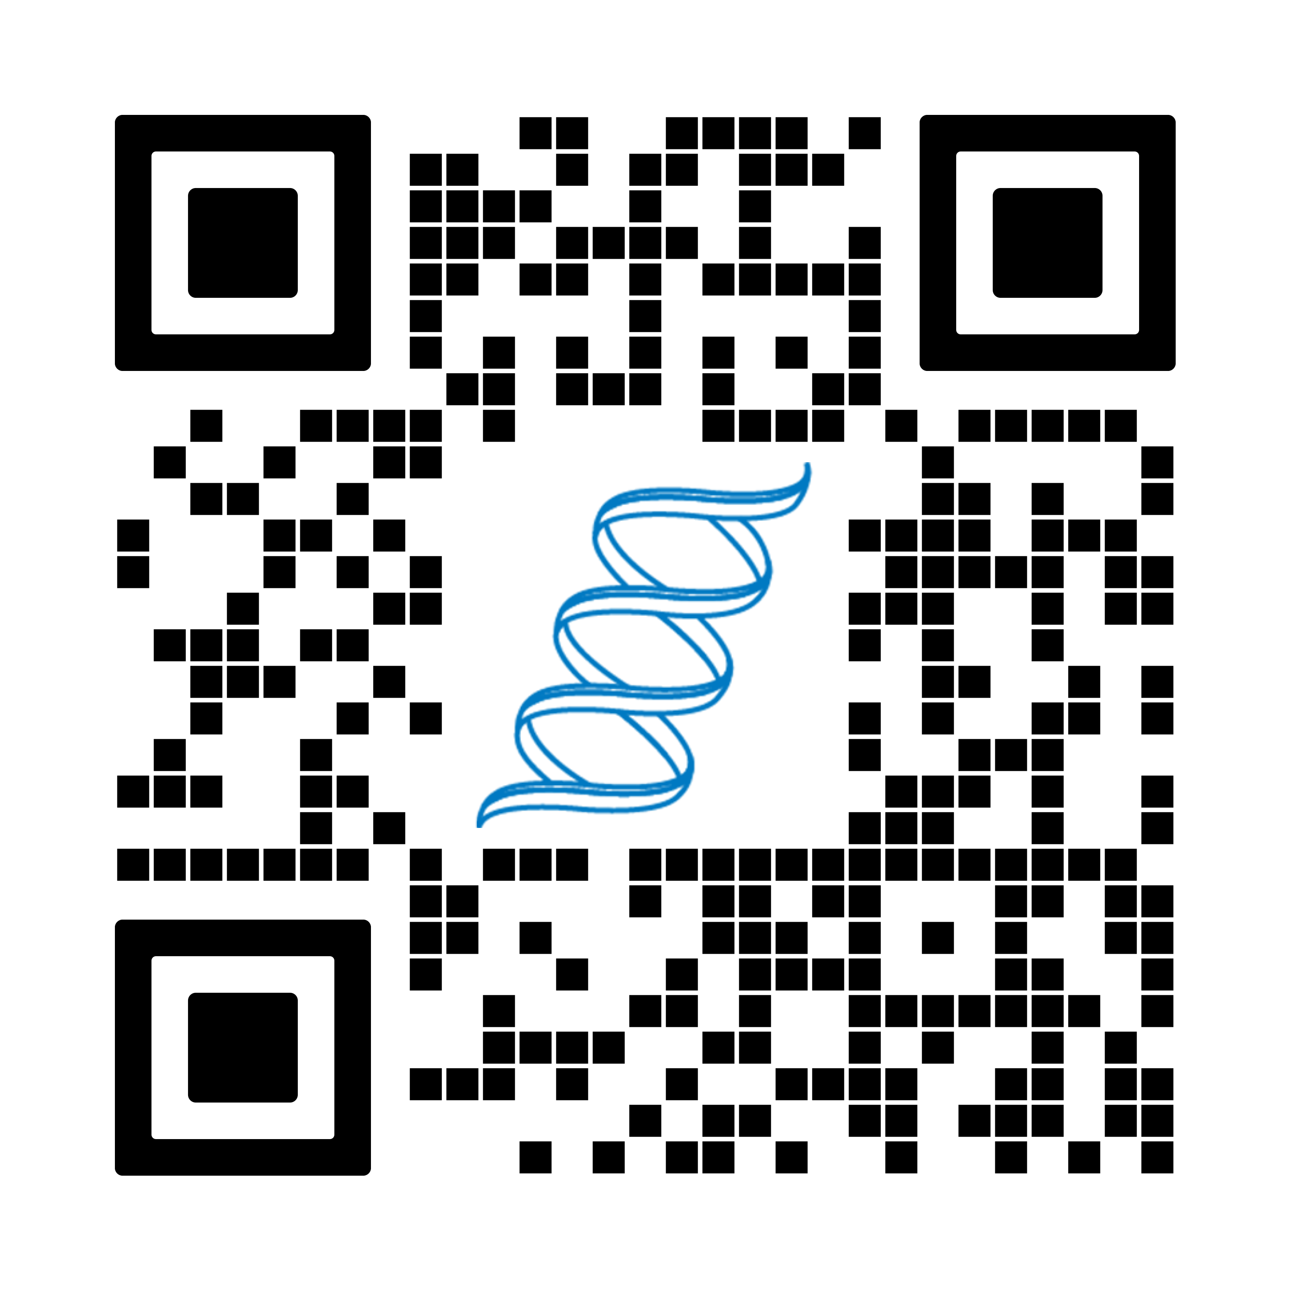
Is building relationships with other scientists important to you?
The ASBMB provides its members many opportunities to bring people together — in small focused conferences and large annual meetings — both virtually and in person, to share their research, make connections and cultivate an interactive scientific community.
Notes:
Examples: virtual workshops, annual meetings, lipids div., fundings (awards, grants, fellowships), Annual meeting, etc.

Slide 5

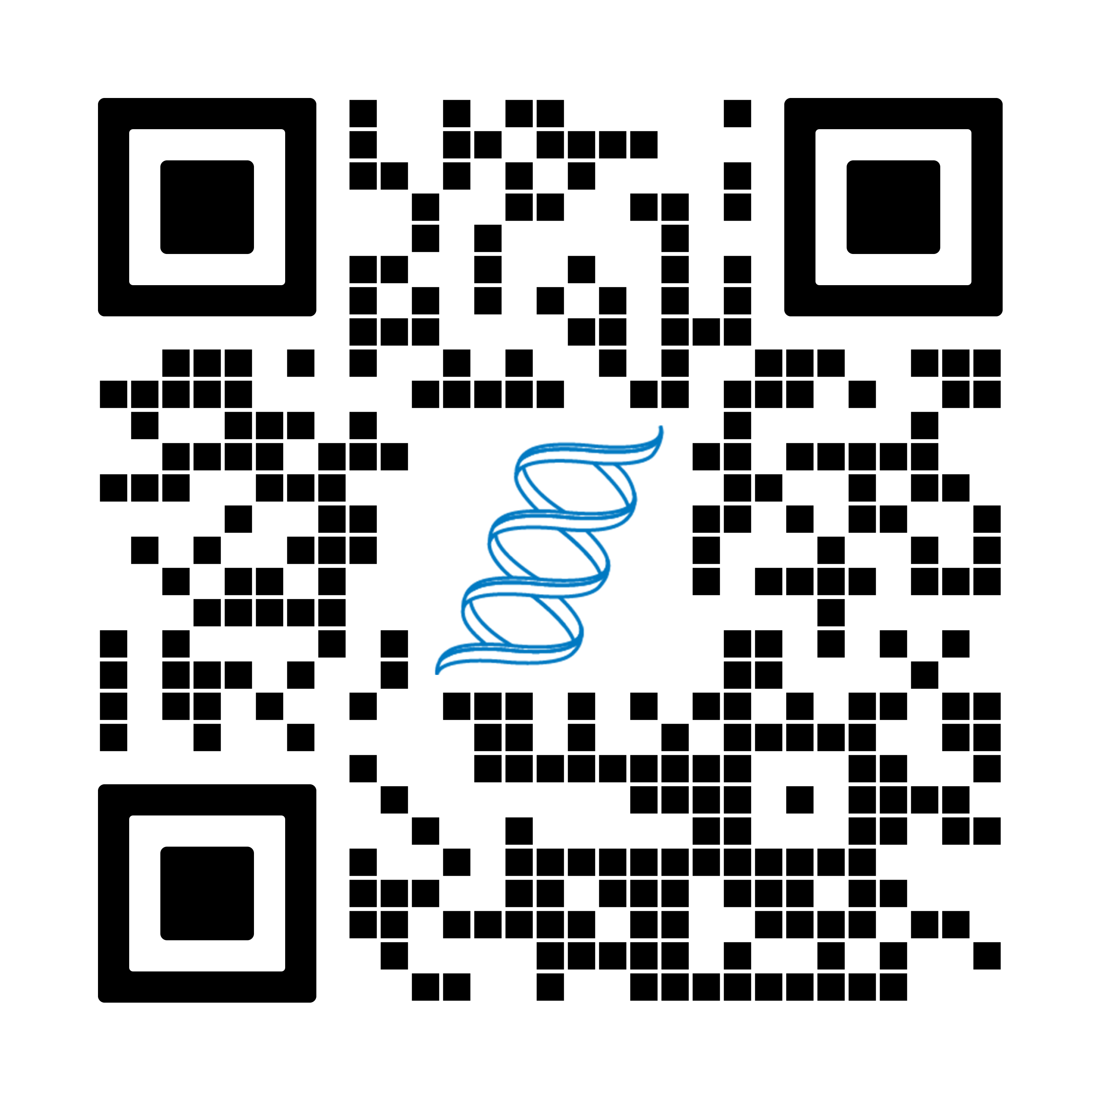
Together we advocate for
molecular life sciences
The ASBMB makes it easy for you to relay your concerns and ambitions to the policy leaders who make decisions that affect the future of the biomedical research enterprise.
We have full-time staff that support your advocacy efforts
We back bills to bolster minority-serving institutions
We work with federal science agencies to increase equity, inclusion and diversity
We advocate for pro-science provisions that become law
We want you to contribute to next year's policy activities!
Notes:
The ASBMB works to ensure that researchers’ voices are heard in Congress and at federal funding agencies

Slide 6
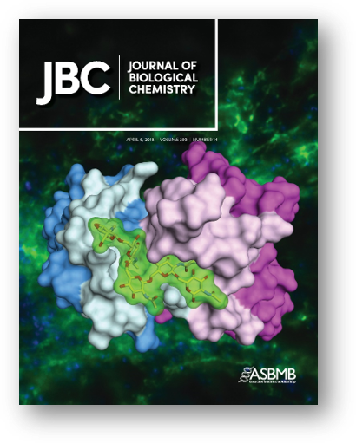
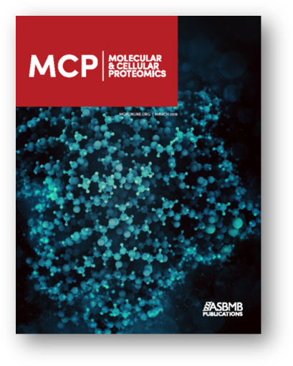
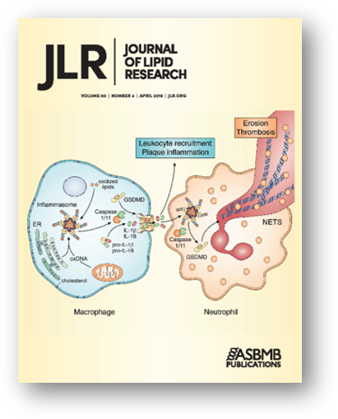

The ASBMB is founded on a tradition of enduring, ground-breaking science
For over 114 years, the ASBMB has been bringing significant and enduring research to the scientific community. The ASBMB publishes three major open-access and peer-reviewed journals
Society journals advance the dissemination of rigorous, high-quality research findings reviewed by experts in the field!
Notes:
$500 discount to publish

Slide 7


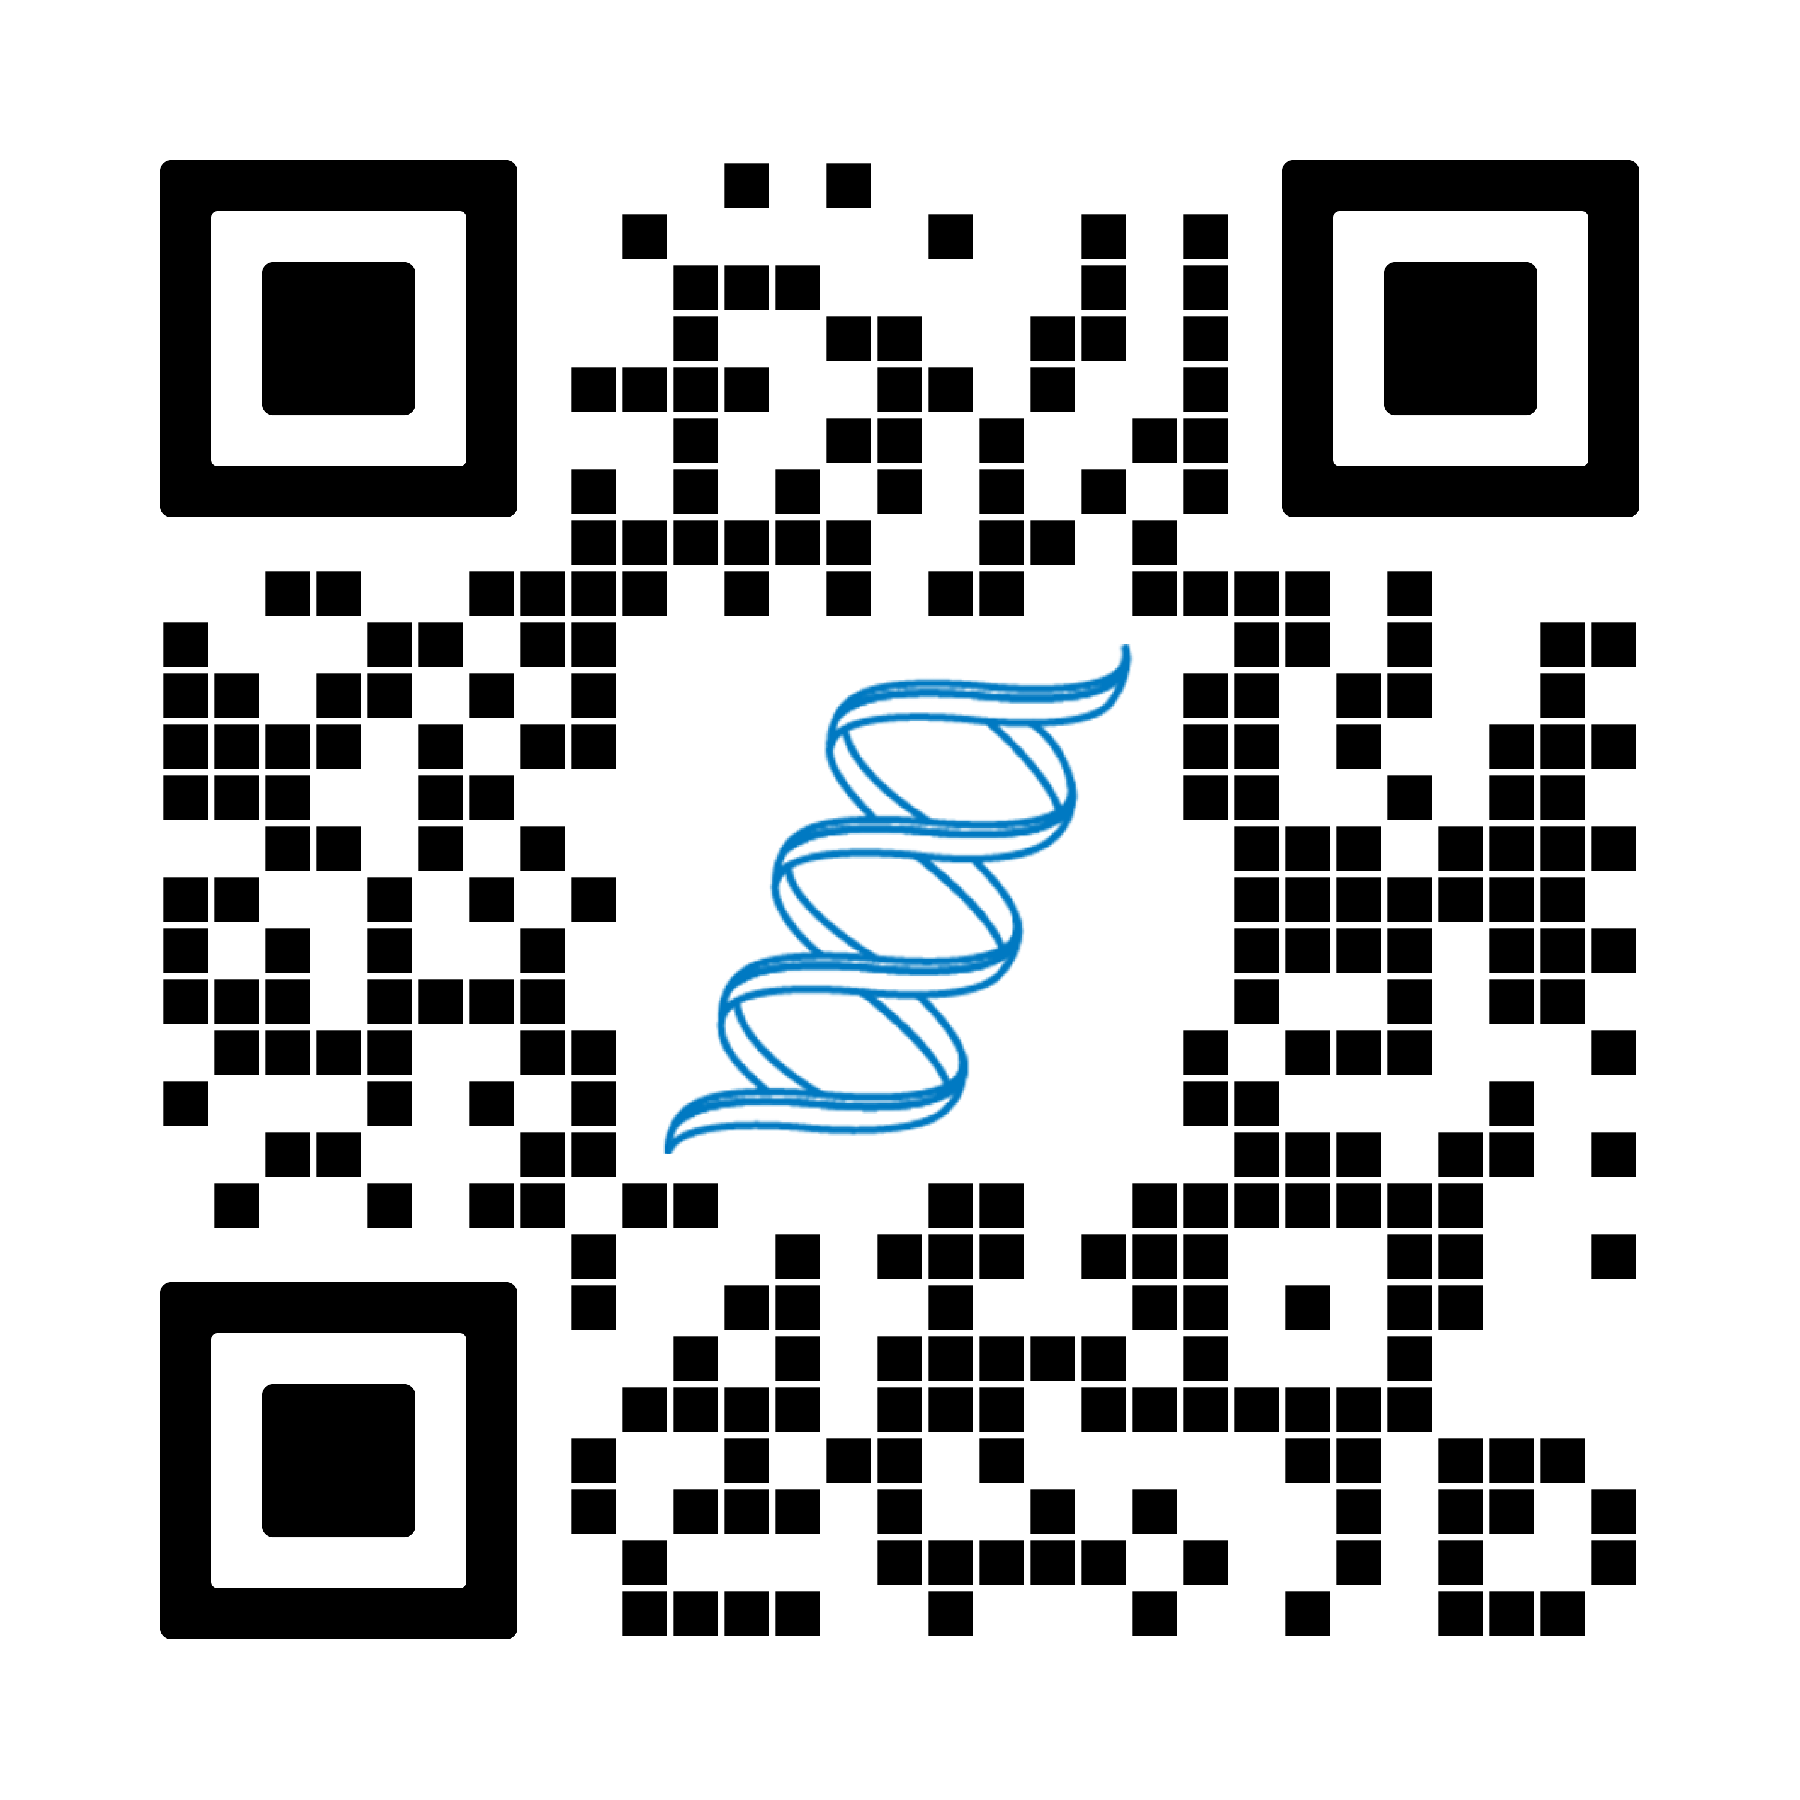
We want you to share your stories!
ASBMB Today is the award-winning member magazine published by the ASBMB. The magazine features:
Investigative reports
Recent trends in biochemistry and molecular biology
New research developments
Personal essays by scientists and science students
Read the latest issue
at asbmb.org/asbmb-today
Notes:
Published monthly
ASBMB members are invited to write for the member magazine.

Slide 8

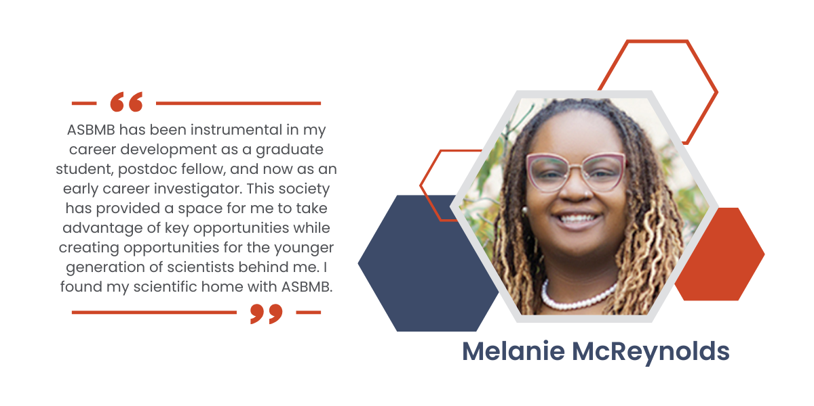
Hear from our members
Quote from speaker
Notes:
ASBMB is always looking to hear from members about their experiences with the Society.

Slide 9

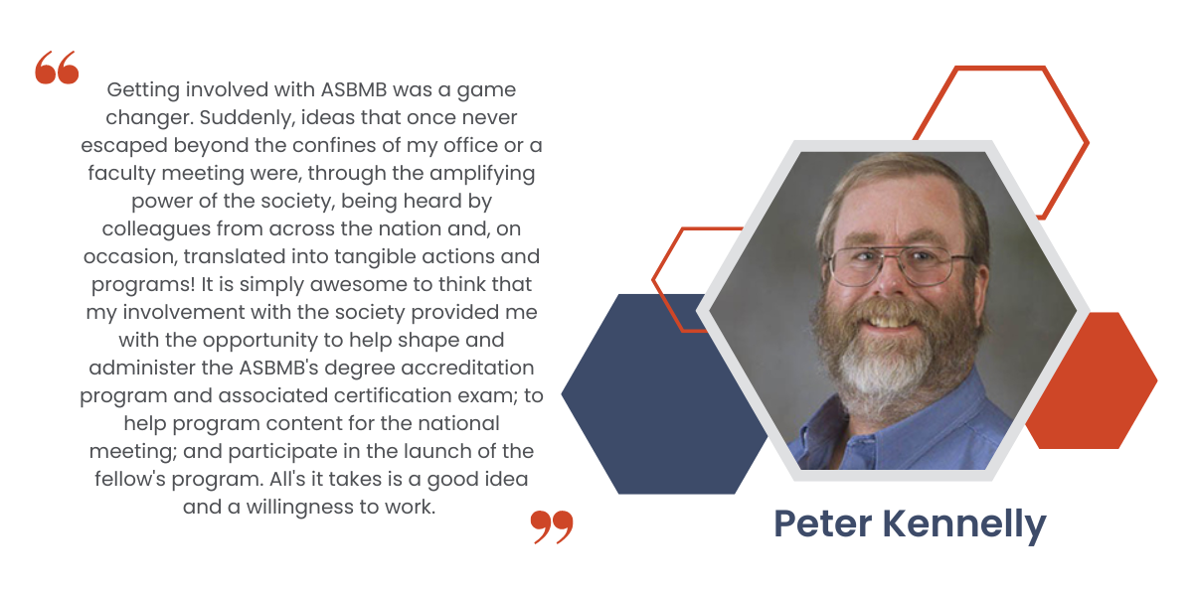
Hear from our members
Quote from speaker
Notes:
ASBMB is always looking to hear from members about their experiences with the Society.

Slide 10
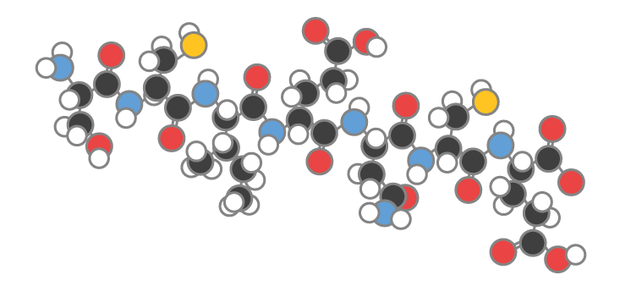
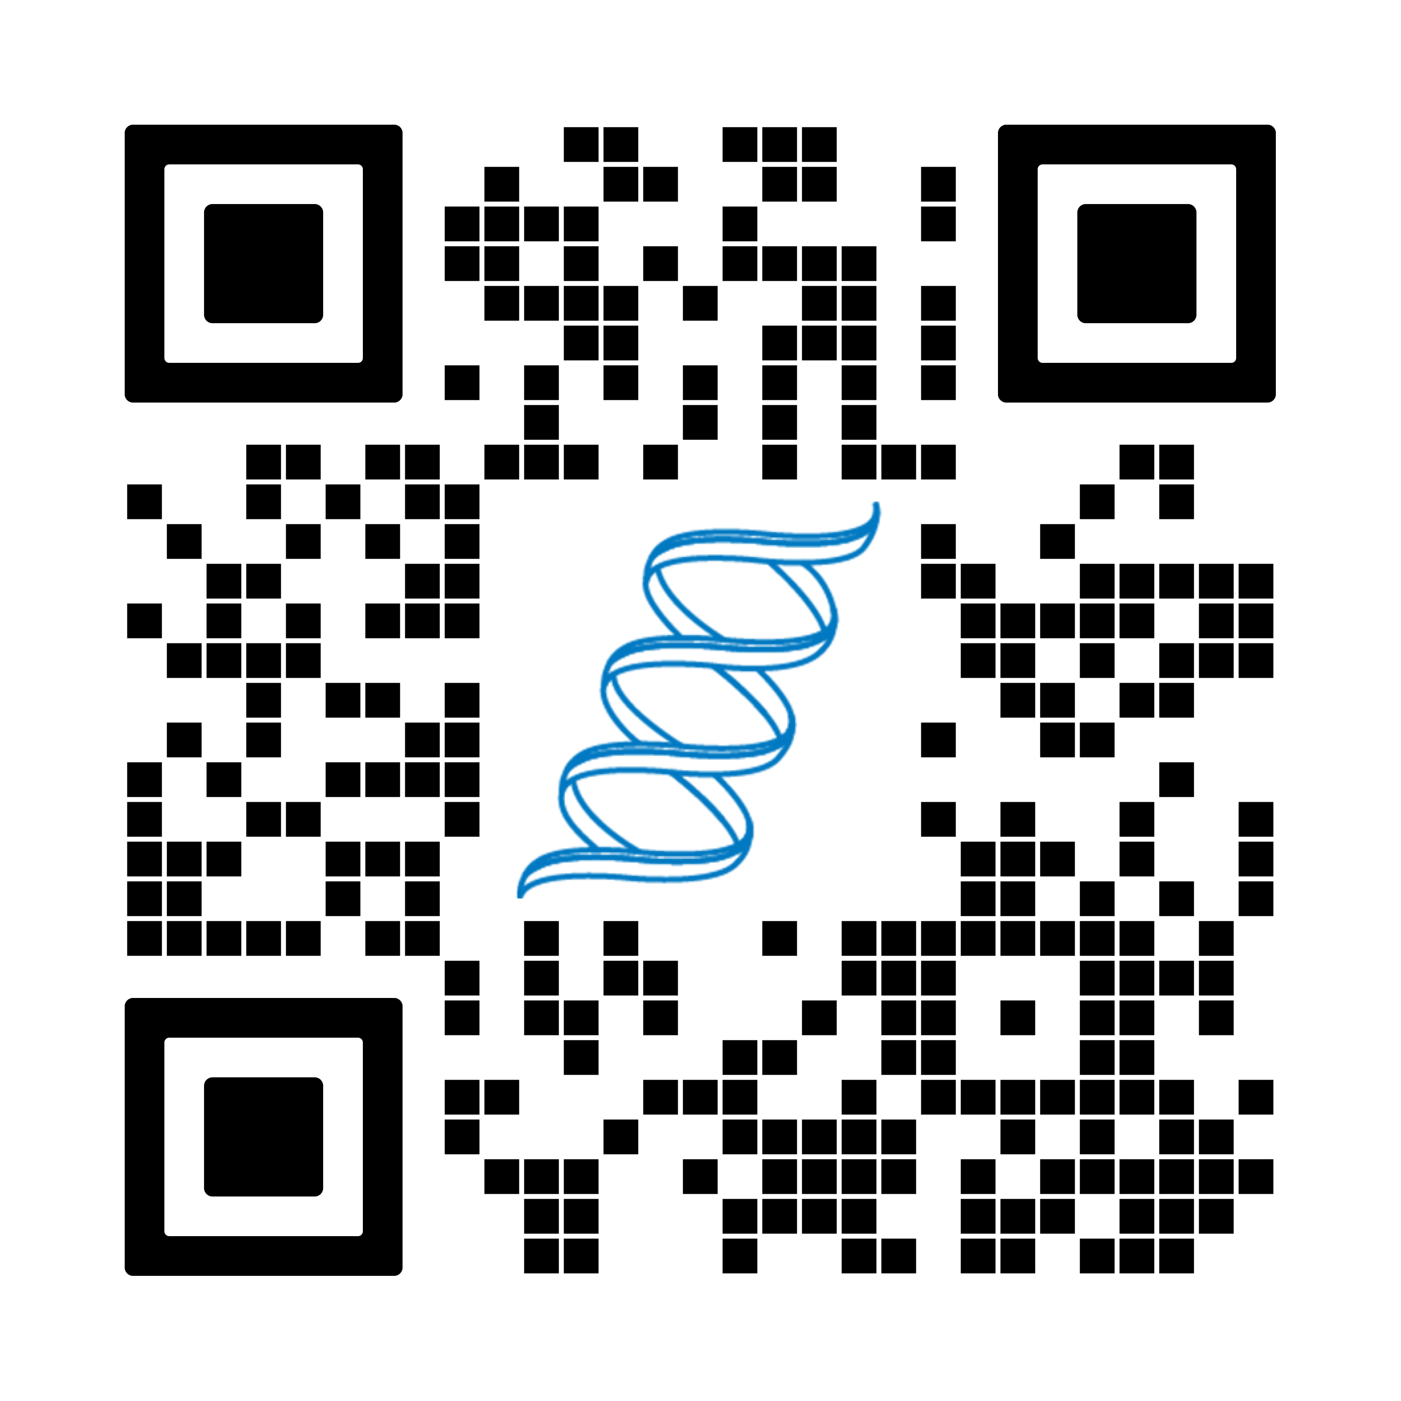
We are the American Society for Biochemistry and Molecular Biology
Join us and start participating now!
Notes:
Use the QR code to join today!
Membership fees: regular/industry ($160), early career ($70), graduate ($25), undergrad ($10), affiliate (45), student chapters

