Slide 1
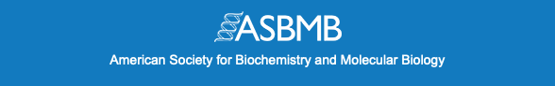


Why join ASBMB?
The American Society for Biochemistry and Molecular Biology
is a diverse community of biochemists and molecular life scientists
Partner with ASBMB for help to advance your career to the next level of the molecular life sciences – whether you work in academia, industry or government
Build relationships and grow your network at conferences and online to share research, ideas and cultivate an interactive scientific community
ASBMB makes it easy for you to relay your concerns and ambitions to the policy leaders who make decisions that affect the future of the research enterprise
Communicate your science in ASBMB journals to advance the dissemination of rigorous, high-quality research findings reviewed by experts
There are a LOT of member benefits – especially for young investigators
Join the ASBMB and start participating – today!

