Slide 1
Core concepts in biochemistry
& molecular biology
Ellis Bell
2015-16 Knapp Chair of the Liberal Arts &
Visiting Distinguished Professor of Chemistry & Biochemistry
Department of Chemistry & Biochemistry
University of San Diego
&
Professor of Chemistry
Laboratory for Structural Biology, Biophysics & Bioinformatics
Department of Chemistry
University of Richmond
NSF #0957205 RCN-UBE:
Promoting Concept Driven Teaching Strategies in Biochemistry and Molecular Biology through Concept Assessments

Slide 2
The 2015-16 RCN Working Group
Cheryl Bailey Duane Sears
Margaret Johnson Rachel Booth
Mike Carastro Regina Stevens-Truss
Neena Grover Joe Provost
John Tansey Pam Mertz
Kristin Fox Debra Martin
Ben Caldwell Jessica Schrader
Marilee Benore Teaster Baird
Ann Aguanno

Slide 3
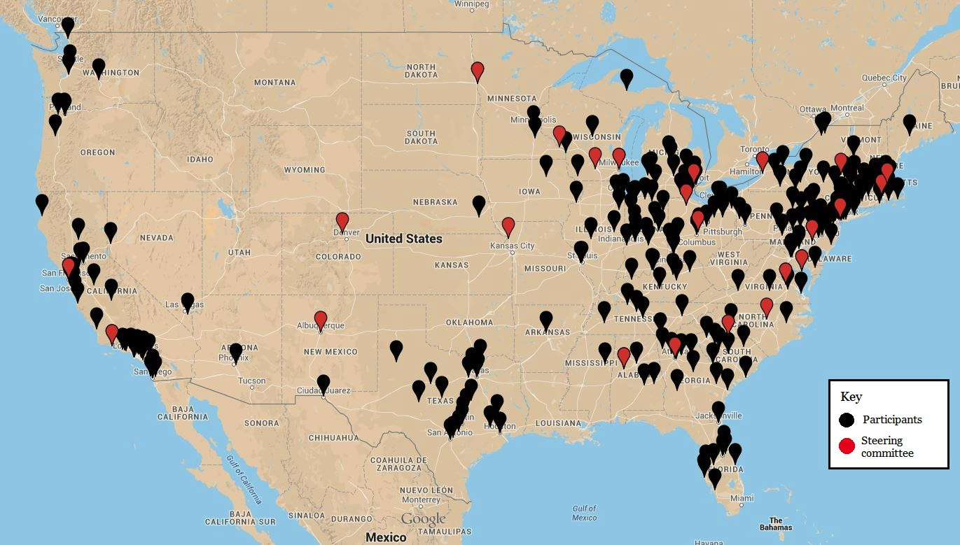
735 faculty from 475 institutions have been
involved in the activities of the network to date

Slide 4
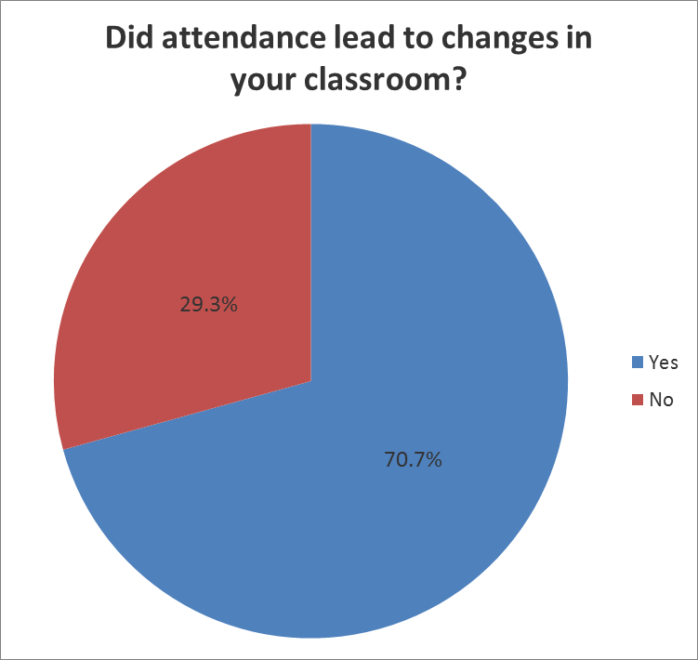
Flash poll results from 2015
of workshop participants to date

Slide 5
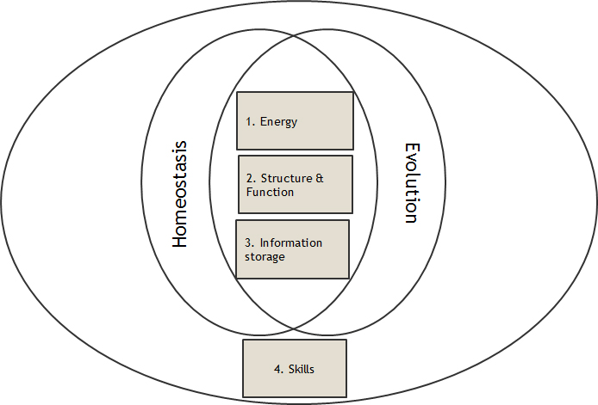
Integration of foundational concepts & skills
with the ASBMB accreditation program

Slide 6
Overview of workshops to date
Focus on scientific teaching: backward design
Focus on foundational concepts
Creation of alignment tables & teaching materials
      Submission to CourseSource biochemistry & molecular biology

Slide 7
Foundational Concepts
(Identified in pre-workshop surveys as areas of interest by participants)
Energy & matter transformation-20%
Biological information-24%
Structure & function-30%
Evolution- 36%
Homeostasis-22%

Slide 8
Foundational skills - top responses
• Given an experimental observation, students should be able to develop a testable and falsifiable hypothesis.
• Given a hypothesis, students should be able to identify the appropriate experimental observations to be measured, as well as appropriate control variables.
• Students should be able to use appropriate equations to analyze experimental data and calculate parameter estimates.
• Students should be able to apply equations and models to predict outcomes of experiments.
• Students should be able to find and use the primary literature.
• Students should be able to use databases and bioinformatics tools.
• Students should be able to use visual and verbal tools to explain concepts and data.
• Students should be able to translate science into everyday examples.
• Given a case study, students should be able to identify and evaluate both scientific and societal ethical aspects.
• Students should be able to discuss cross-disciplinary concepts such as modularity, energy, etc.

Slide 9
Allied fields - top responses
• Students should be able to recall force laws and apply them in the context of molecular structure and molecular interactions.
• Students should be able to recall principles and theories regarding waves, light, optics, and imaging, and apply them in the context of biochemical investigations.
• Students should be able to recall concepts of energetics and order, and apply them in the context of biological macromolecules.
• Students should be able to recall concepts of thermodynamics, and apply them in the context of thermal processes at the molecular level.
• Students should be able to recall principles of chemical structure (i.e., covalent bonds, polarity, the hydrophobic effect, hydrogen bonds and other non-covalent interactions), and apply them in the context of the dynamic aspects of molecular structure.
• Students should be able to recall theories that govern chemical reactions (i.e., collision theory, transition state theory, rate laws and equilibria), and apply them in the context of biomolecular structure and reactivity.
• Students should be able to recall a range of mathematical functional relationships (i.e., linear, exponential, saturation, and sigmoidal functions),apply them in the context of the molecular life sciences, assess whether the function is appropriate, and predict biomolecular outcomes based on mathematical equations.

Slide 10
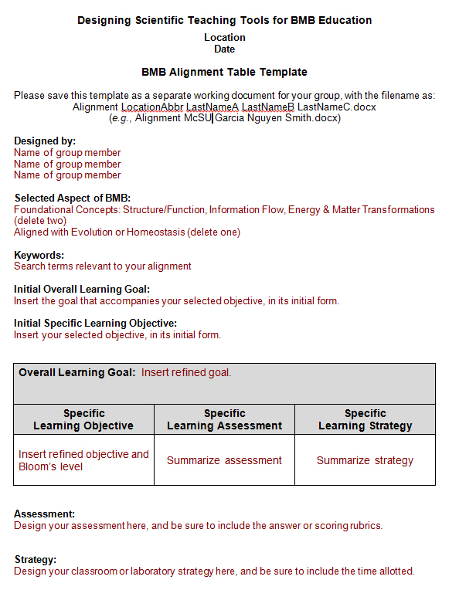

Slide 11
Strategies
Overall learning goal Students should understand the core concept of macromolecular structure, including the nature of biological macromolecules and factors that impact structure.
Using principles of reverse design:
Specific learning objectives | Learning assessments | Learning strategies
Students should be able to compare and contrast various biologically relevant macromolecules and macromolecular assemblies… | T/F or Multiple choice (3 pts.) | Pre-class reading (1 participation pt.) In-class group activity Table of biomolecules (5 participation pts.)
Students should be able to sketch various biologically relevant macromolecules and macromolecular assemblies… | Sketch a polymer (monomers – 2 pts.) (linkage – 1 pts.)
Students should be able to defend classifications of unfamiliar, biologically relevant macromolecules and macromolecular assemblies… | Defend an evaluation (classify – 1 pt.) (defend – 2 pts.) | Clicker question 1 correct classification (2 participation pts.)
… in terms of the basic repeating units of the polymer and the types of linkages between them.
Introduction
Goals
Objectives
Assessments
Strategies
Summary

Slide 12
2015-2016 focus
2 year - 4 year transitions
Developing and sharing assessments of skills in combination with concept areas at introductory and advanced levels
Sharing best practices for teaching

Slide 13
Early adopters to mainline teaching strategies
Identifying the barriers
Catalyzing change: lowering the activation energy
Focus on concepts and skills
CUREs (course-based undergraduate research experiences)
Interdisciplinary or blended courses

Slide 14
If you would like to be involved please contact:
Ellis Bell, jbell@sandiego.edu
Erica Siebrasse, esiebrasse@asbmb.org

Slide 15
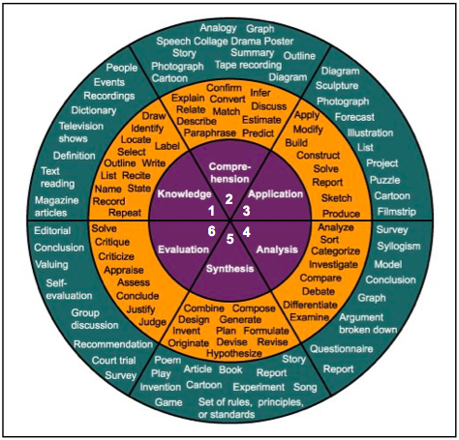
Bloom’s Taxonomy of Educational Objectives
Levels
Verbs
Strategies
Adapted from Kristin Millet’s Wikispace at http://kristen-millet.wikispaces.com, accessed October 23, 2013.
Introduction
Goals
Objectives
Assessments
Strategies
Summary

Slide 16
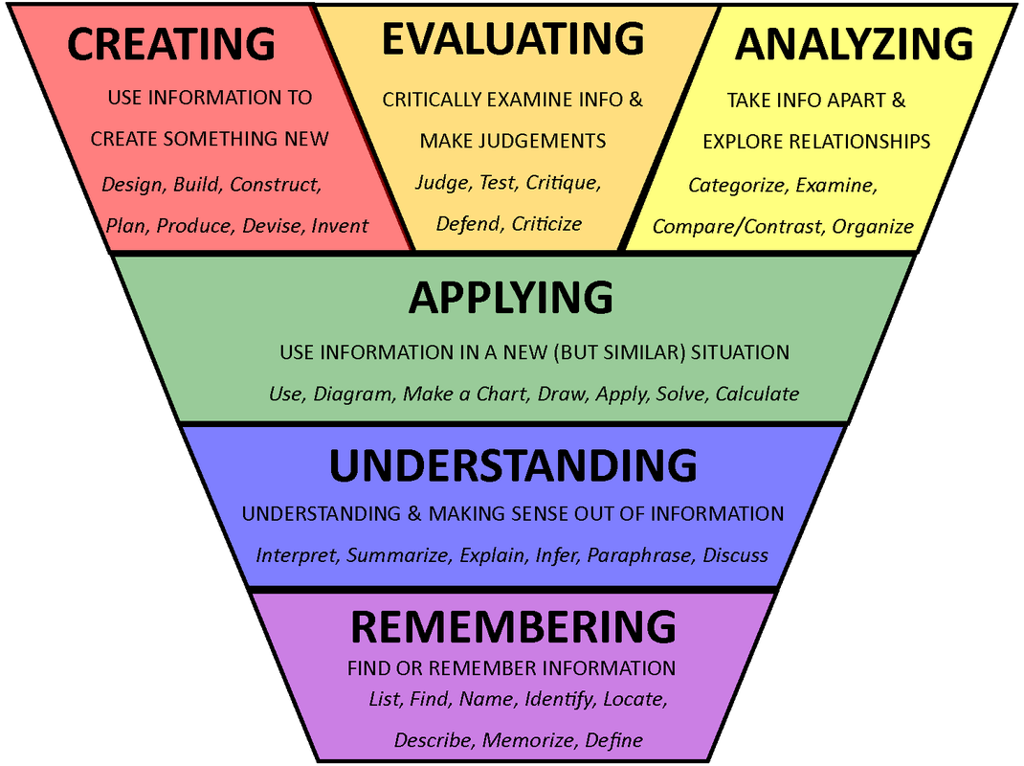
Bloom’s Taxonomy of Educational Objectives
Introduction
Goals
Objectives
Assessments
Strategies
Summary

Slide 17
Schedule for the day
• 9:00 - 9:30 AM | Arrival and check-in
• 9:30 - 10:00 AM | Introduction and overview of the day’s activities, Ellis Bell, University of San Diego
• 10:00 AM – 12:00 PM | Workshop I - Developing and sharing best practices
Participants will select a BMB learning goal and work in groups to design a short, student-centered classroom activity to teach that goal and outline a complementary assessment.
• 12:00 - 12:45 PM | Lunch (provided)
• 12:45 – 1:45 PM | Keynote lecture, Rik van Antwerpen, Virginia Union University
• 1:45 – 2:45 PM | Workshop II
Participants will continue developing their activity and assessment.
• 2:45 – 3:15 PM | Break
• 3:15 – 5:30 PM | Workshop III
Participants will present their activities to the group for discussion. They will then have time to refine their work and will electronically submit it to the ASBMB for later use in the project.
• 5:30-6:00 PM | Wrap up and final discussion

Slide 18
Workshop I – Developing and sharing best practices
Participants will select a BMB learning goal and work in groups to design a short, student-centered classroom activity to teach that goal and outline a complementary assessment.

Slide 19
Strategies
Overall Learning Goal
Using Principles of Reverse Design:
Specific Learning Objectives | Learning Assessments | Learning Strategies
… in terms of the basic repeating units of the polymer and the types of linkages between them.
Introduction
Goals
Objectives
Assessments
Strategies
Summary

Slide 20
Workshop II
Participants will briefly report out on their developing activity and assessment.
Discussion and ideas from the group

Slide 21
Workshop III
3.15-4.15pm:
Groups present their final activities to the group for discussion.
4.15-5.30pm:
Time to refine work, and using the provided template,
electronically submit it to the ASBMB for later use in the project.

