Slide 1
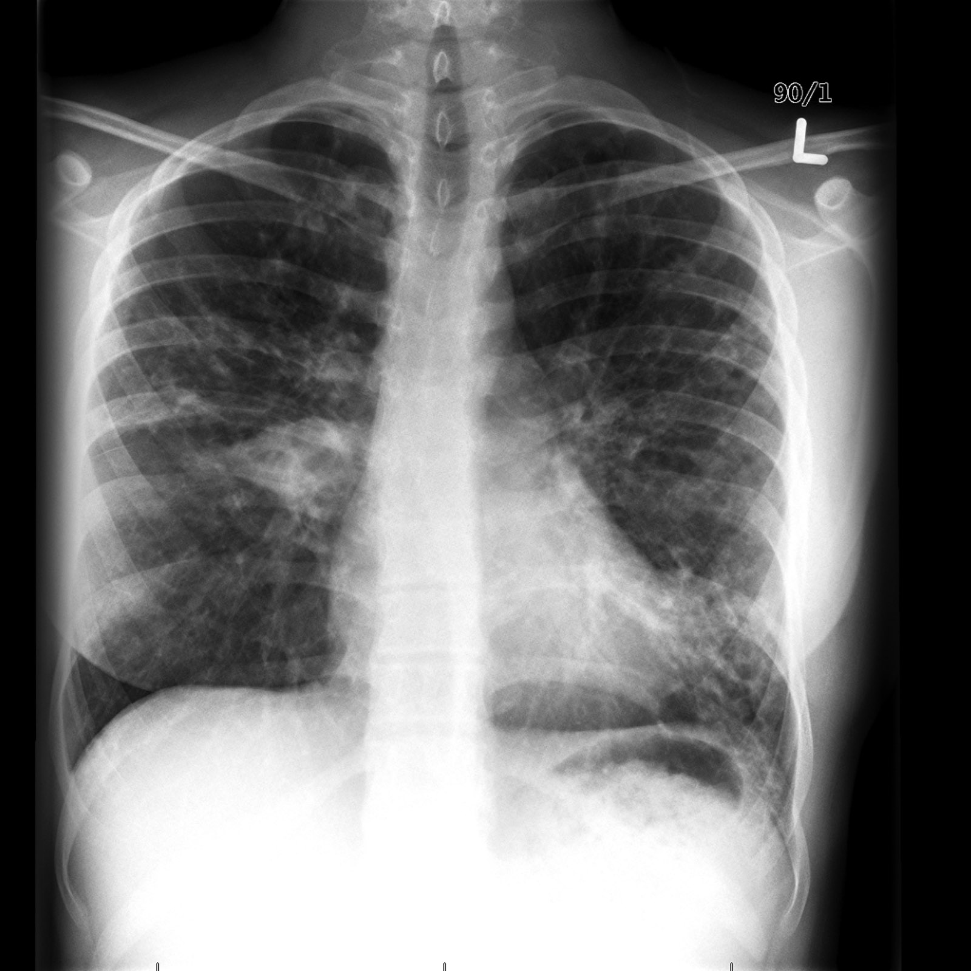
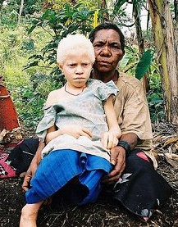
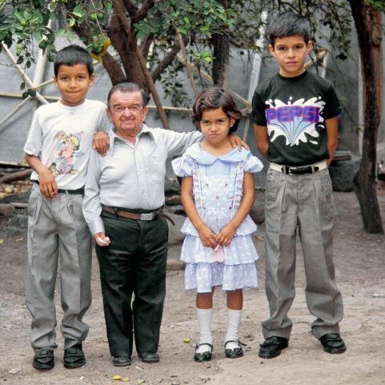
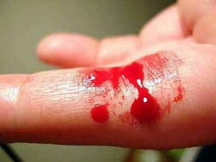
WHAT DO THEY HAVE IN COMMON?
ALBINISM
DWARFISM
https://commons.wikimedia.org
http://discovermagazine.com/
CYSTIC FIBROSIS
HEMOPHILIA
http://radiopaedia.org/
https://commons.wikimedia.org
THEY ARE GENETIC DISEASES (DISORDERS)
Notes:
Hopefully they have heard of some of these four diseases. Introduce them briefly.
Genetic diseases are inherited, not like “other” diseases (flu, HIV, cholera, etc.).
Goal: understand genetic diseases.

Slide 2
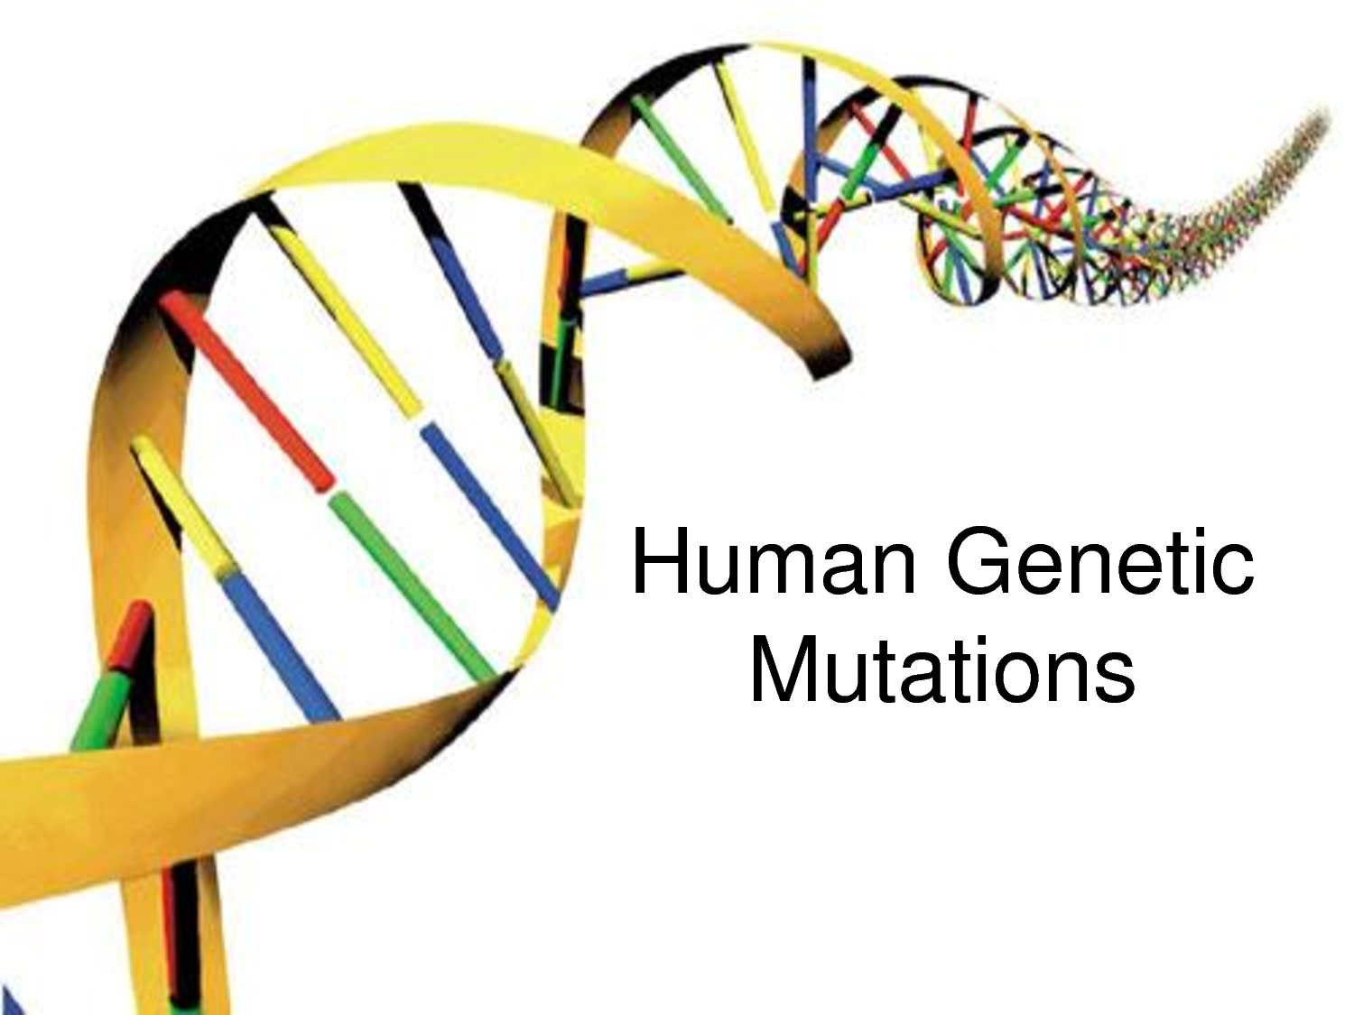
GENES, MUTATIONS & DISEASES:
UNDERSTANDING THE ORIGINS OF GENETIC DISORDERS
http://www.raogk.org/dna/

Slide 3
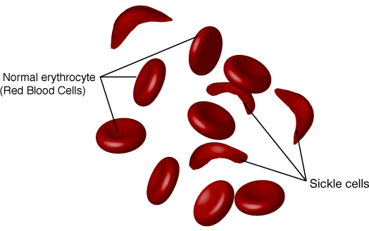
SICKLE-CELL ANEMIA IS A GENETIC DISEASE
http://geneed.nlm.nih.gov/
Notes:
Describe sickle cell disease, symptoms.
We’ll be using sickle cell as our “model” (example) of a genetic disease throughout our lessons and activities.
First, learn “genetics”.

Slide 4
LESSON #1

Slide 5
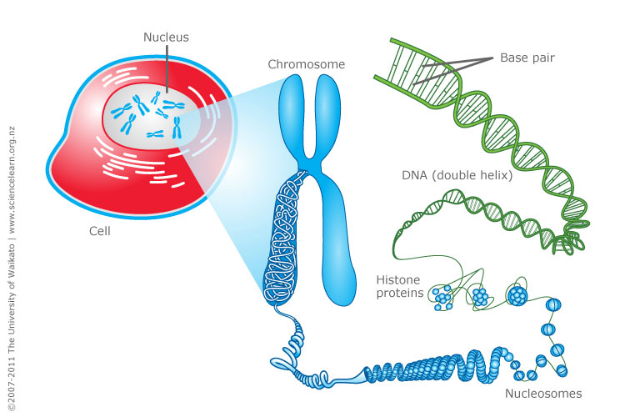
genetic
gene
- set of instructions, typically to make a protein
- fundamental unit of heredity
- composed of deoxyribonucleic acid (DNA)
nucleus
chromosome
DNA

Slide 6
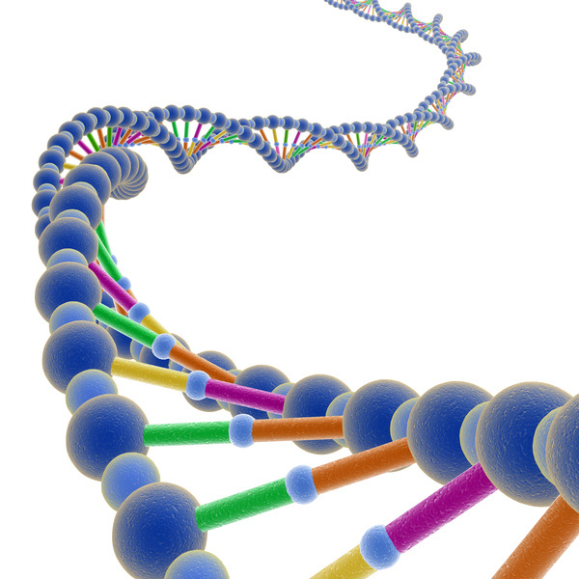
gene
DNA
http://igbiologyy.blogspot.com/
- DNA is composed of two strands of nucleic acids
- nucleic acids are composed of nucleotides
nucleotide
http://www.livescience.com/

Slide 7
phosphate
G
C
A
T
DNA
sugar
T
A
base
http://www.livescience.com/
Four different bases give rise to four different nucleotides in DNA.
-bases: adenine (A), guanine (G),
cytosine (C), and thymine (T)
-pairing of bases: A with T
G with C

Slide 8
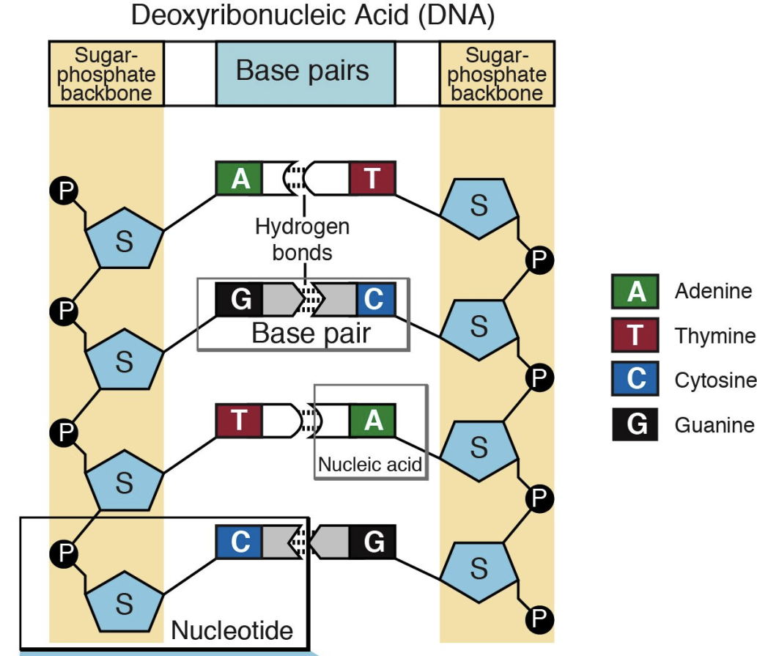
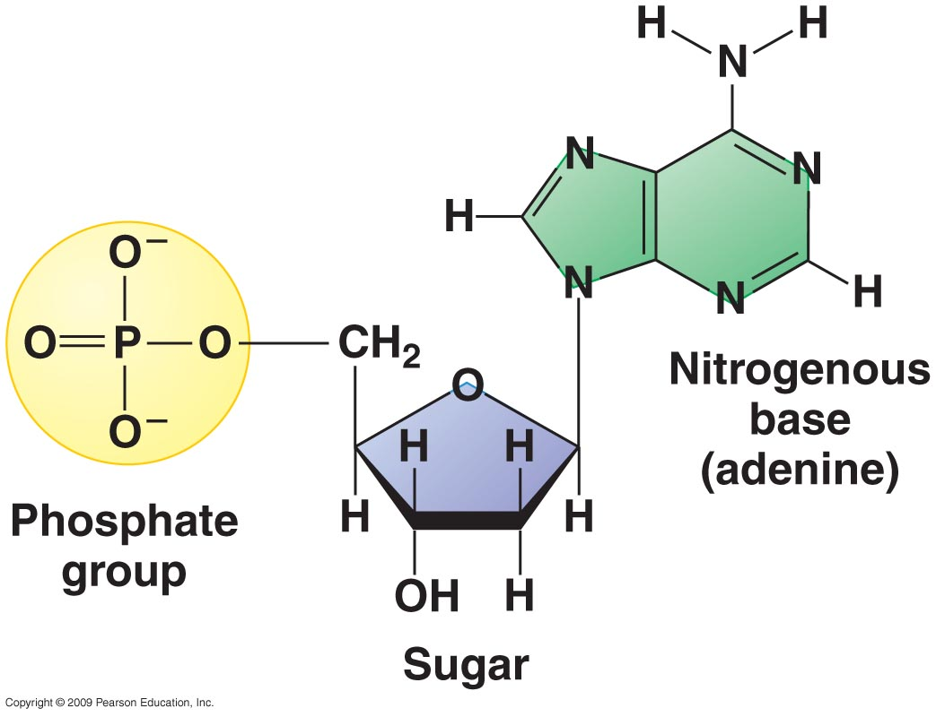
http://dnarnanews.blogspot.com/
http://knowgenetics.org/
Base-pairing occurs through hydrogen bonds.
Phosphate groups (therefore, DNA molecules too) carry negative charges.

Slide 9
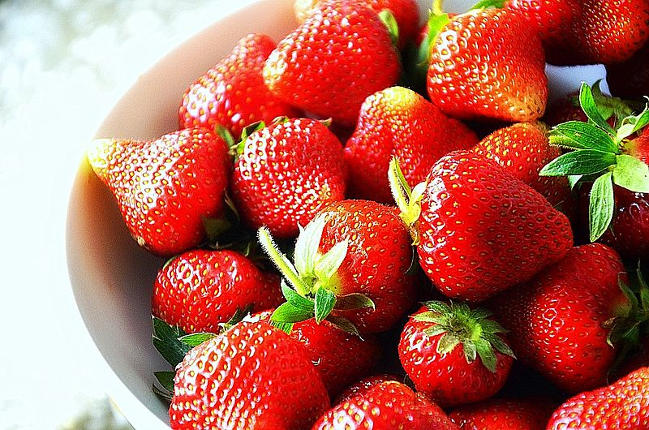
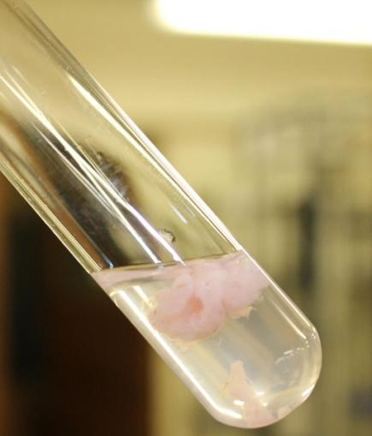
ACTIVITY #1
EXTRACTING AND VISUALIZING DNA
Break cells open and precipitate DNA using extraction buffer.
When DNA comes out of solution it tends to clump together, which makes it visible.
You will take the clump, re-suspend it in water and run a gel to see if it actually is DNA.
As comparison, you will also run samples of water and protein.
https://commons.wikimedia.org

Slide 10
Agarose Gel Electrophoresis
Ladder #1 #2 #3 #4
Electrophoresis
  Uses an electrical current to separate molecules with different charges
Agarose
  Used separate molecules by shape and size
Agarose Gel Electrophoresis
  Pulls molecules through an agarose gel using an electrical current
( - )
Power Source
OFF
ON
( + )
1200 bps
500 bps
250 bps
125 bps
100 bps
A DNA ladder is added so you can determine the size of your DNA fragments
Notes:
Click 1) Here is an agarose gel with a stain for DNA (SYBR-SAFE) already added. A DNA Ladder which separates into bands of known size and 4 samples of mixed DNA have been added to each well. The key on the side shows what each mixture may contain.
Since DNA is negatively charged, an electric current is used. The negative electrode is connected to the top of the gel were the DNA is and the positive electrode is connected to the opposite end of the gel. By turning on the power source, the DNA will migrate through the gel towards the positive charge, separating by size. As a result, the smaller the DNA segment, the faster it will migrate through the gel. Click to turn on the power source and run your gel!
Click 2) After running the gel, you can see which segments of DNA were in each of the samples loaded. Notice that in Lane #4, no DNA samples were present.

Slide 11
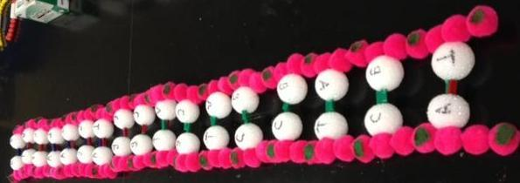
ACTIVITY #2
MAKING A DNA MODEL
Models are used by scientists to describe ideas, understand biological processes and make predictions.
Each bench has one strand of DNA.
Build the complementary strand using the free nucleotides at your bench.
The magnetic bars represent the hydrogen bonds.
After building your model, twist the strands.

